Slide 1
Substation and Distribution Automation
Module 2: Modeling of distribution level components

Slide 2
Module 1 Overview
Part 1: Overhead Lines
Part 2: Underground lines
Part 3: Three Phase Transformer Models
Part 4: Center –Tapped Transformers and Secondaries
Part 5: IEEE Test Systems

Slide 3
Part 1: Overhead Lines
Series impedance of Overhead Lines
Transposed Three-phase Lines
Untransposed Distribution Lines
Carson’s Equations
Modified Carson’s Equations
Primitive Impedance Matrix for Overhead Lines
Phase Impedance Matrix for Overhead Lines
Sequence Impedances
Parallel Overhead Distribution Lines
Shunt Admittance of Overhead Parallel Lines
General Voltage Drop Equation (examples from Kevin)

Slide 4
Series impedance of Overhead Lines
Critical step before the analysis of the distribution feeder can begin.
Resistance component of the conductors is typically taken from a look-up table (can be found in Appendix A of the text book)
The reactance comes from the inductive reactance (self and mutual) of the conductors. The inductive reactance is due to the magnetic field surrounding the conductors.

Slide 5
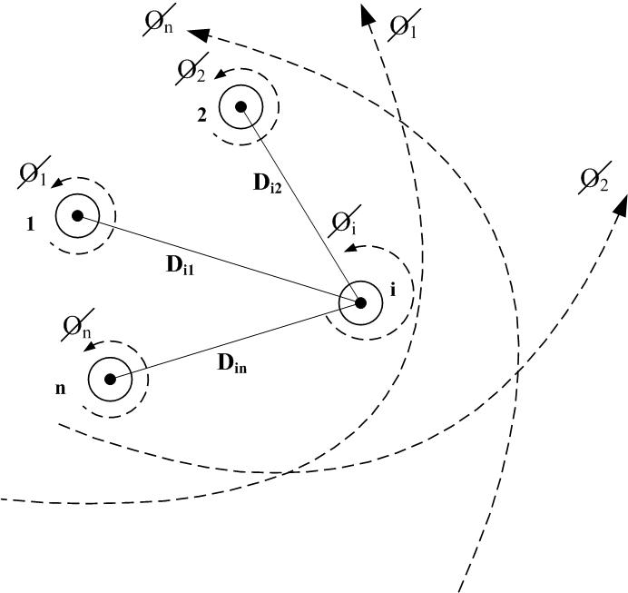
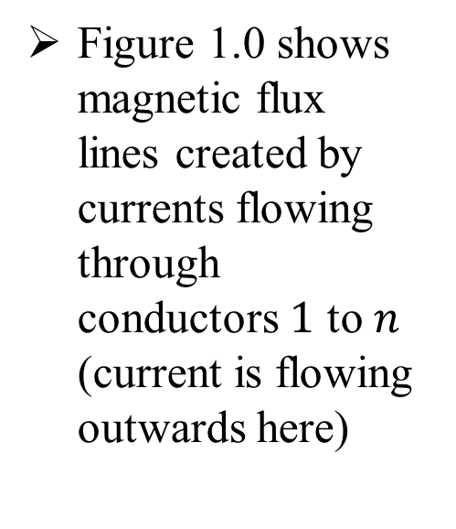
Series impedance of Overhead Lines
Figure 1.0 shows magnetic flux lines created by currents flowing through conductors $1$ to $n$ (current is flowing outwards here)
Figure 1.0

Slide 6
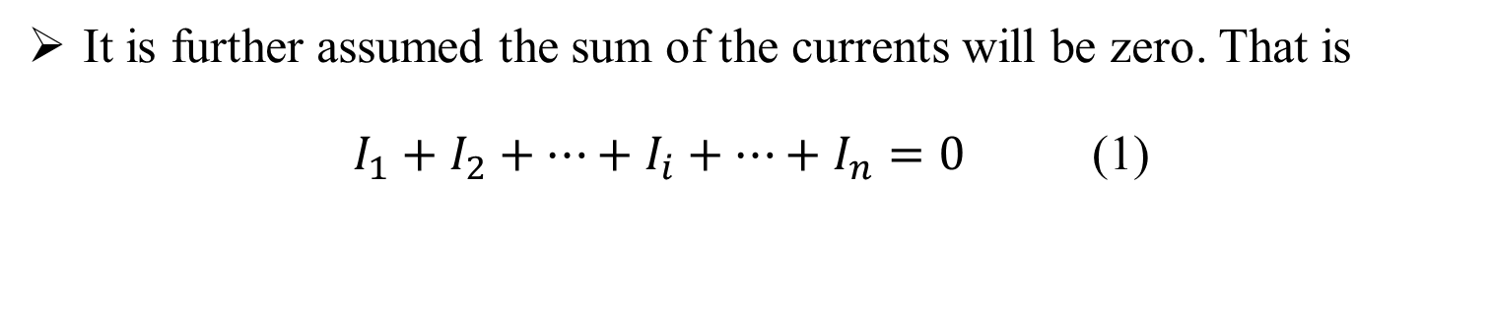
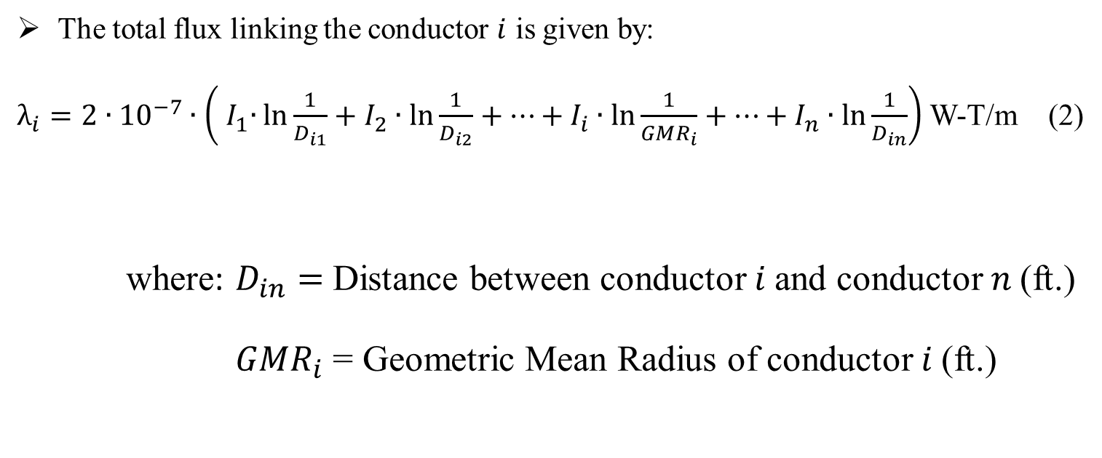
Series impedance of Overhead Lines (Contd…)
It is further assumed the sum of the currents will be zero. That is
$I_{1}+I_{2}+⋯+I_{i}+⋯+I_{n}=0$ (1)
The total flux linking the conductor $i$ is given by:
$λ_{i}=2∙{10}^{−7}∙\left({ I}_{1}∙\ln{\frac{1}{D_{i1}}}+I_{2}∙\ln{\frac{1}{D_{i2}}}+⋯+I_{i}∙\ln{\frac{1}{GMR_{i}}}+⋯+I_{n}∙\ln{\frac{1}{D_{in}}}\right)$ W-T/m (2)
where: $D_{in}=$ Distance between conductor $i$and conductor $n$(ft.)
$GMR_{i}$ = Geometric Mean Radius of conductor $i$(ft.)

Slide 7
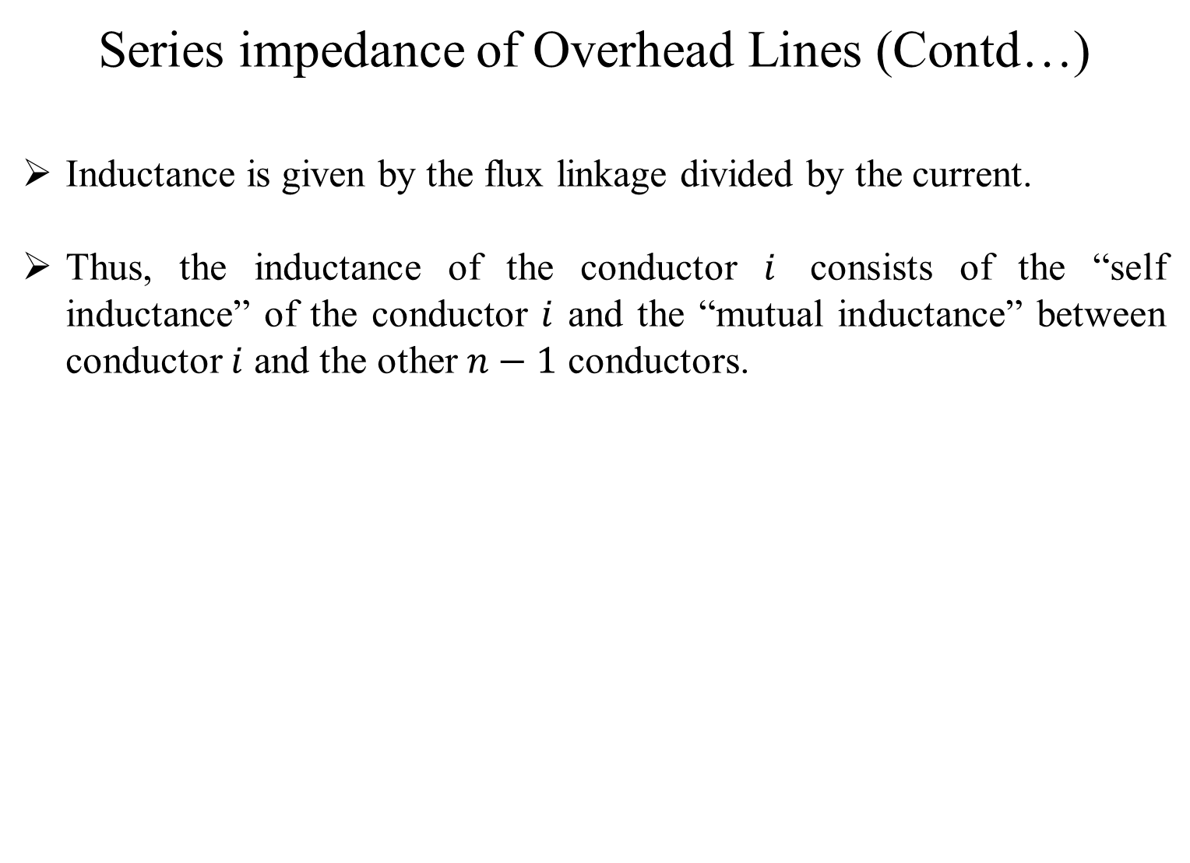
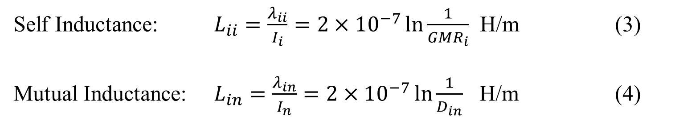
Series impedance of Overhead Lines (Contd…)
Inductance is given by the flux linkage divided by the current.
Thus, the inductance of the conductor $i$ consists of the “self inductance” of the conductor $i$ and the “mutual inductance” between conductor $i$ and the other $n−1$ conductors.
Self Inductance: $L_{ii}=\frac{λ_{ii}}{I_{i}}=2×{10}^{−7}\ln{\frac{1}{{GMR}_{i}}}$ H/m (3)
Mutual Inductance: $L_{in}=\frac{λ_{in}}{I_{n}}=2×{10}^{−7}\ln{\frac{1}{D_{in}}}$ H/m (4)

Slide 8
Part 1: Overhead Lines
Series impedance of Overhead Lines
Transposed Three-phase Lines
Untransposed Distribution Lines
Carson’s Equations
Modified Carson’s Equations
Primitive Impedance Matrix for Overhead Lines
Phase Impedance Matrix for Overhead Lines
Sequence Impedances
Parallel Overhead Distribution Lines
Shunt Admittance of Overhead Parallel Lines
General Voltage Drop Equation

Slide 9
Series impedance of Overhead Lines
Transposed Three-phase Lines
Usual assumptions made for High-Voltage Transmission lines:
Transposed – Each phase occupies the same physical position on the structure for one-third of the length of the line.
Balanced Loading – All phases are equally loaded.
Hence “self” and “mutual” inductance terms can be combined into one “phase” inductance.
The series impedance per phase of a transposed three-phase line consisting of one conductor per phase is given by:
Series Impedance: $z_{i}=r_{i}+j0.12134∙ \ln{\frac{D_{eq}}{GMR_{i}}}$ Ω/mile (5)

Slide 10
Part 1: Overhead Lines
Series impedance of Overhead Lines
Transposed Three-phase Lines
Untransposed Distribution Lines
Carson’s Equations
Modified Carson’s Equations
Primitive Impedance Matrix for Overhead Lines
Phase Impedance Matrix for Overhead Lines
Sequence Impedances
Parallel Overhead Distribution Lines
Shunt Admittance of Overhead Parallel Lines
General Voltage Drop Equation

Slide 11
Series impedance of Overhead Lines (Contd…)
Untransposed Distribution Lines
Distribution Systems consist of single-phase, two-phase and untransposed three-phase lines serving unbalanced loads.
Hence it is necessary to retain the identity of the self and mutual impedance terms of the conductors in addition to taking into account the ground return path for the unbalanced currents.
The resistance of the conductors is taken directly from the table of conductor data.

Slide 12
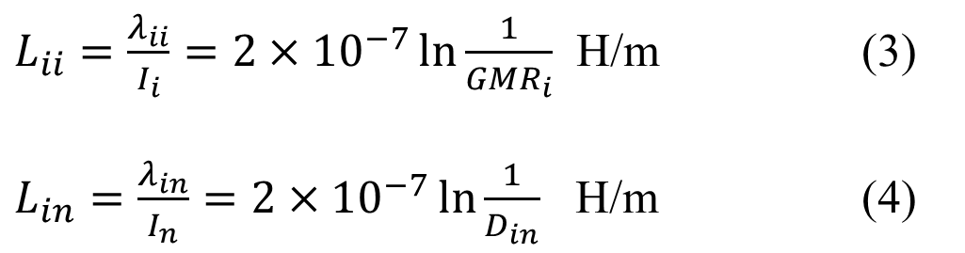
Series impedance of Overhead Lines (Contd…)
Untransposed Distribution Lines
Equations (3) and (4) are used to calculate self and mutual reactances of the conductors.
Recall:
$L_{ii}=\frac{λ_{ii}}{I_{i}}=2×{10}^{−7}\ln{\frac{1}{{GMR}_{i}}}$ H/m (3)
$L_{in}=\frac{λ_{in}}{I_{n}}=2×{10}^{−7}\ln{\frac{1}{D_{in}}}$ H/m (4)

Slide 13
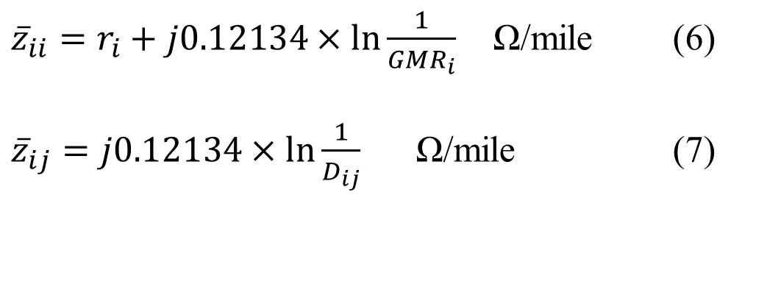
Series impedance of Overhead Lines (Contd…)
Untransposed Distribution Lines
Assumptions
Inductive reactance will be at a frequency of 60 Hz.
Length of the conductor is one mile.
The self and mutual impedances are given by
${\overline{z}}_{ii}=r_{i}+j0.12134×\ln{\frac{1}{GMR_{i}}}$ Ω/mile (6)
${\overline{z}}_{ij}=j0.12134×\ln{\frac{1}{D_{ij}}}$ Ω/mile (7)

Slide 14
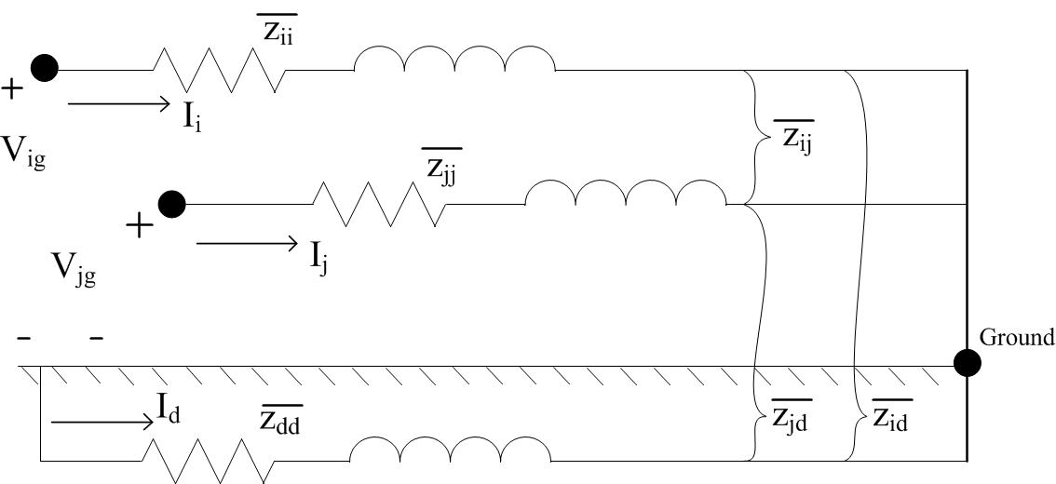
Two Conductors with Dirt Return
Figure 2.0

Slide 15
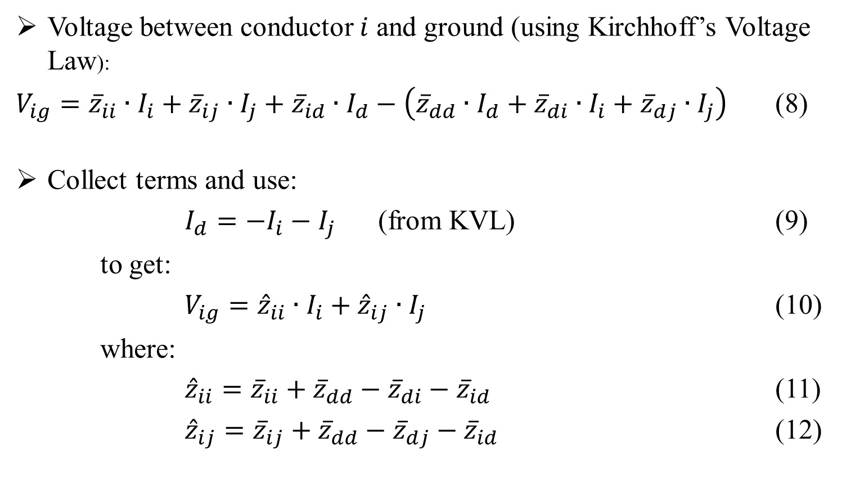
Two Conductors with Dirt Return
Voltage between conductor $i$ and ground (using Kirchhoff’s Voltage Law):
$V_{ig}={\overline{z}}_{ii}∙I_{i}+{\overline{z}}_{ij}∙I_{j}+{\overline{z}}_{id}∙I_{d}−\left({\overline{z}}_{dd}∙I_{d}+{\overline{z}}_{di}∙I_{i}+{\overline{z}}_{dj}∙I_{j}\right)$ (8)
Collect terms and use:
$I_{d}=−I_{i}−I_{j}$ (from KVL) (9)
to get:
$V_{ig}={\hat{z}}_{ii}∙I_{i}+{\hat{z}}_{ij}∙I_{j}$ (10)
where:
${\hat{z}}_{ii}={\overline{z}}_{ii}+{\overline{z}}_{dd}−{\overline{z}}_{di}−{\overline{z}}_{id}$ (11)
${\hat{z}}_{ij}={\overline{z}}_{ij}+{\overline{z}}_{dd}−{\overline{z}}_{dj}−{\overline{z}}_{id}$ (12)

Slide 16
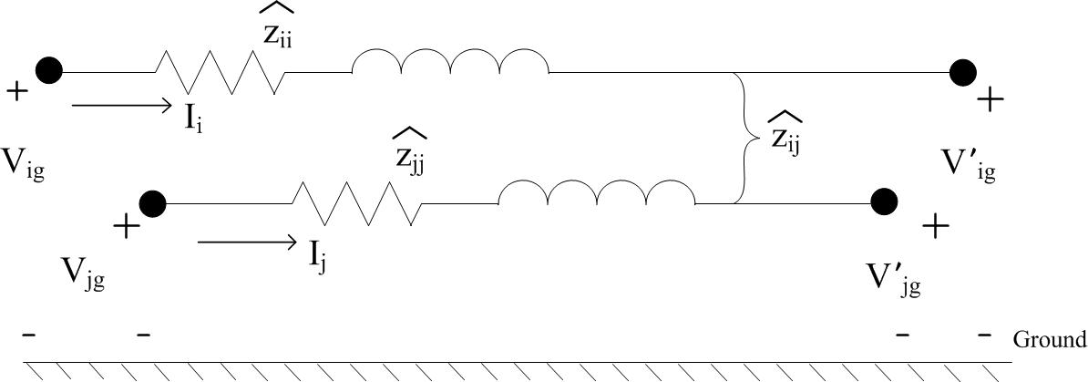
Series impedance of Overhead Lines (Contd…)
Primitive Circuit Impedances
Figure 3.0

Slide 17
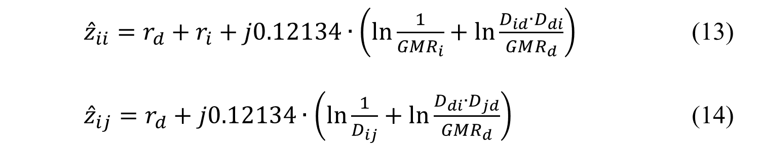
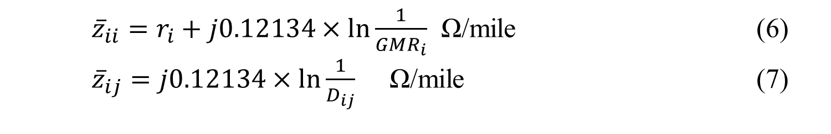
Series impedance of Overhead Lines (Contd…)
Primitive Circuit Impedances
Substitute the self and mutual impedance equations:
${\overline{z}}_{ii}=r_{i}+j0.12134×\ln{\frac{1}{GMR_{i}}}$ Ω/mile (6)
${\overline{z}}_{ij}=j0.12134×\ln{\frac{1}{D_{ij}}}$ Ω/mile (7)
into our “hat” impedances (eq’s 11 and 12)
to get the primitive self and mutual impedances:
${\hat{z}}_{ii}=r_{d}+r_{i}+j0.12134∙\left(\ln{\frac{1}{GMR_{i}}}+\ln{\frac{D_{id}∙D_{di}}{GMR_{d}}}\right)$ (13)
${\hat{z}}_{ij}=r_{d}+j0.12134∙\left(\ln{\frac{1}{D_{ij}}}+\ln{\frac{D_{di}∙D_{jd}}{GMR_{d}}}\right)$ (14)

Slide 18
Part 1: Overhead Lines
Series impedance of Overhead Lines
Transposed Three-phase Lines
Untransposed Distribution Lines
Carson’s Equations
Modified Carson’s Equations
Primitive Impedance Matrix for Overhead Lines
Phase Impedance Matrix for Overhead Lines
Sequence Impedances
Parallel Overhead Distribution Lines
Shunt Admittance of Overhead Parallel Lines
General Voltage Drop Equation

Slide 19
Series impedance of Overhead Lines (Contd…)
Carson’s Equations
Because distribution is inherently unbalanced, the most accurate analysis should not make any assumptions regarding :
the spacing between conductors
conductor sizes
transposition
Carson assumes the earth is an infinite, uniform solid, with a flat uniform upper surface and a constant resistivity.
Any “end effects” introduced at the neutral grounding points are not large at power frequencies, and there, are neglected.

Slide 20
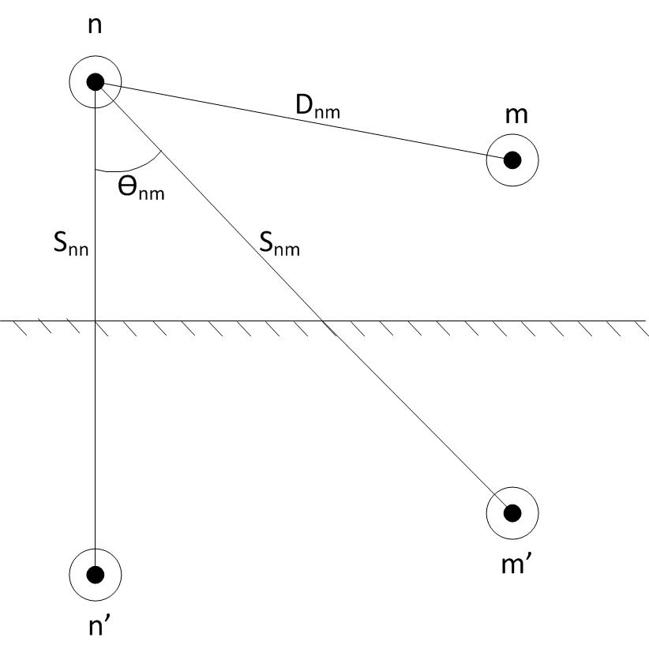
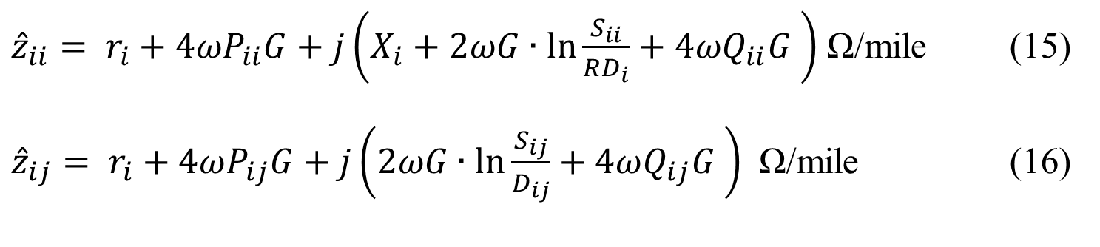
Series impedance of Overhead Lines (Contd…)
Carson’s Equations
Carson made use of conductor images; that is, every conductor at a given distance above ground has an image conductor at the same distance below-ground.
Figure 4.0
Self Impedance:
${\hat{z}}_{ii}= r_{i}+4ωP_{ii}G+j\left(X_{i}+2ωG∙\ln{\frac{S_{ii}}{RD_{i}}}+4ωQ_{ii}G \right)$ Ω/mile (15)
${\hat{z}}_{ij}= r_{i}+4ωP_{ij}G+j\left(2ωG∙\ln{\frac{S_{ij}}{D_{ij}}}+4ωQ_{ij}G \right)$ Ω/mile (16)
Mutual Impedance:

Slide 21
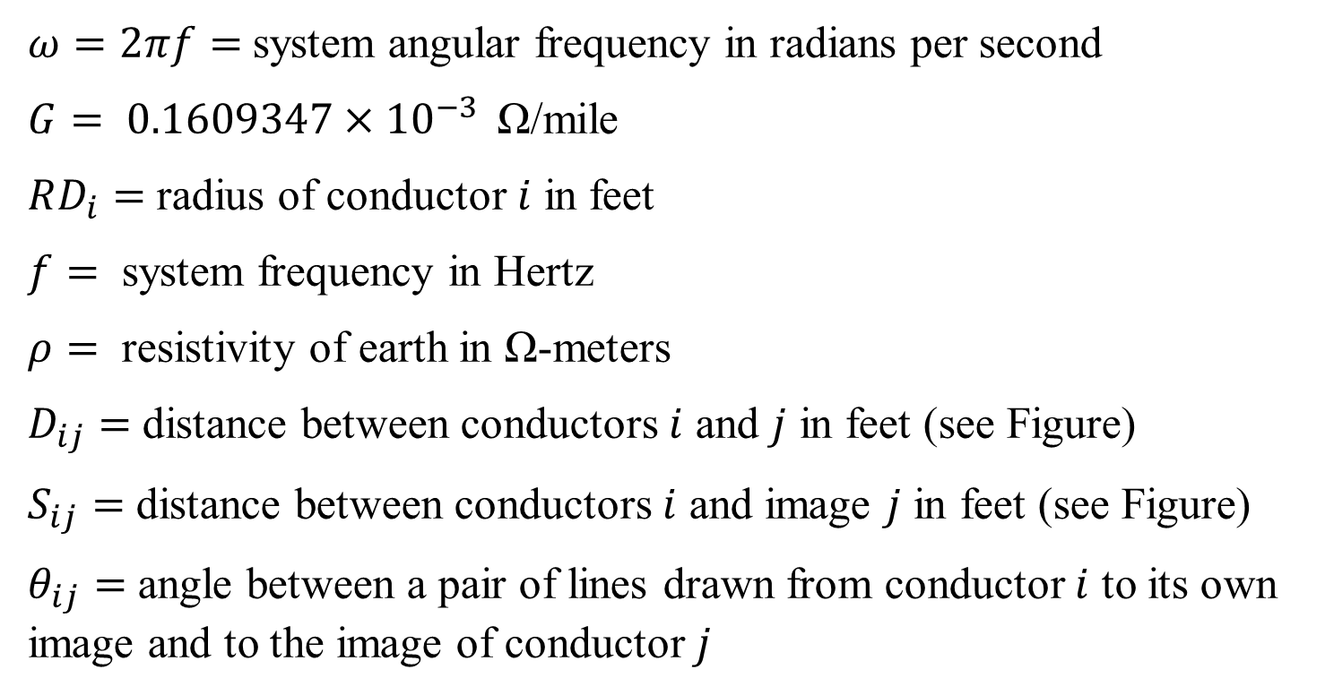
Series impedance of Overhead Lines (Contd…)
Carson’s Equations
Variable Definitions
$ω=2πf=$system angular frequency in radians per second
$G= 0.1609347×{10}^{−3 }$ Ω/mile
$RD_{i}=$ radius of conductor $i$ in feet
$f=$ system frequency in Hertz
$ρ=$ resistivity of earth in Ω-meters
$D_{ij}=$ distance between conductors $i$ and $j$ in feet (see Figure)
$S_{ij}=$ distance between conductors $i$ and image $j$ in feet (see Figure)
$θ_{ij}=$ angle between a pair of lines drawn from conductor $i$ to its own image and to the image of conductor $j$

Slide 22
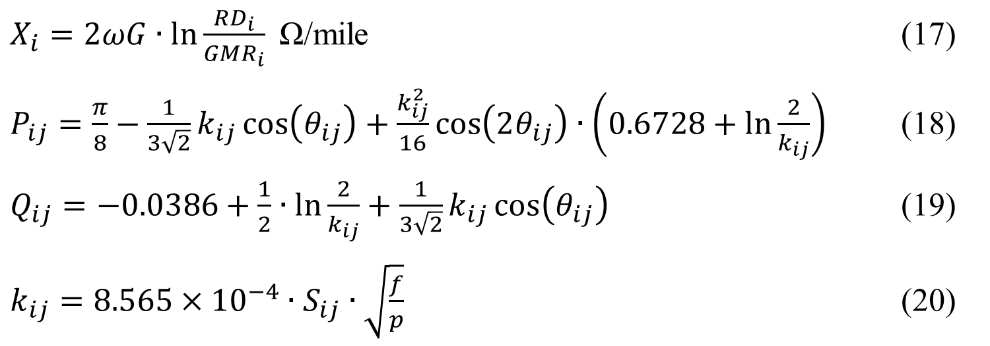
Series impedance of Overhead Lines (Contd…)
Carson’s Equations
Variable Definitions (Contd…)
$X_{i}=2ωG∙\ln{\frac{RD_{i}}{GMR_{i}}}$ Ω/mile (17)
$P_{ij}=\frac{π}{8}−\frac{1}{3\sqrt{2}}k_{ij}\cos\left(θ_{ij}\right)+\frac{k_{ij}^{2}}{16}\cos\left(2θ_{ij}\right)∙\left(0.6728+\ln{\frac{2}{k_{ij}}}\right)$ (18)
$Q_{ij}=−0.0386+\frac{1}{2}∙\ln{\frac{2}{k_{ij}}}+\frac{1}{3\sqrt{2}}k_{ij}\cos\left(θ_{ij}\right)$ (19)
$k_{ij}=8.565×{10}^{−4}∙S_{ij}∙\sqrt{\frac{f}{p}}$ (20)

Slide 23
Part 1: Overhead Lines
Series impedance of Overhead Lines
Transposed Three-phase Lines
Untransposed Distribution Lines
Carson’s Equations
Modified Carson’s Equations
Primitive Impedance Matrix for Overhead Lines
Phase Impedance Matrix for Overhead Lines
Sequence Impedances
Parallel Overhead Distribution Lines
Shunt Admittance of Overhead Parallel Lines
General Voltage Drop Equation

Slide 24
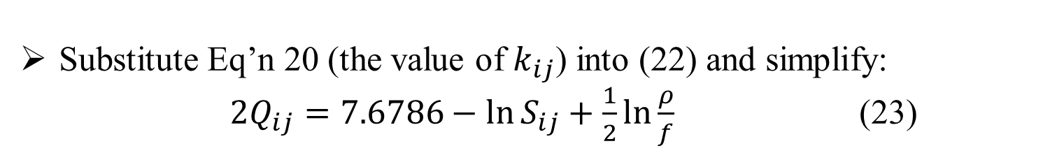
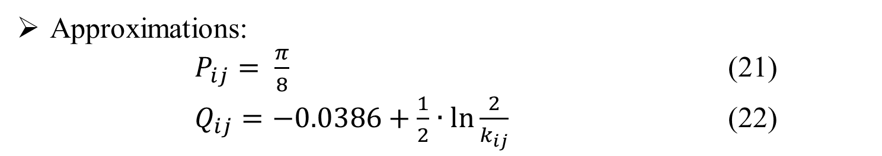
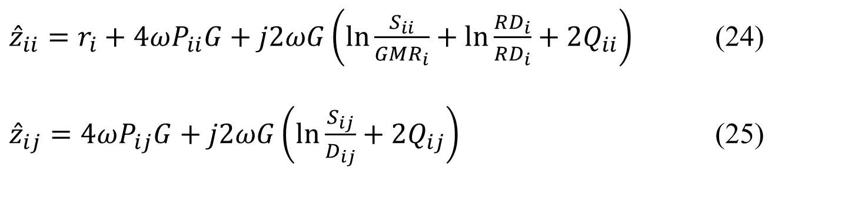
Modified Carson’s Equations: Derivation
Approximations:
$P_{ij}= \frac{π}{8}$ (21)
$Q_{ij}=−0.0386+\frac{1}{2}∙\ln{\frac{2}{k_{ij}} }$ (22)
Substitute Eq’n 20 (the value of $k_{ij}$) into (22) and simplify:
$2Q_{ij}=7.6786−\ln{S_{ij}}+\frac{1}{2}\ln{\frac{ρ}{f}}$ (23)
Now simplify the Carson’s Eq’s (substituting $X_{i}$ in the first):
${\hat{z}}_{ii}=r_{i}+4ωP_{ii}G+j2ωG\left(\ln{\frac{S_{ii}}{GMR_{i}}+\ln{\frac{RD_{i}}{RD_{i}}}}+2Q_{ii}\right)$ (24)
${\hat{z}}_{ij}=4ωP_{ij}G+j2ωG\left(\ln{\frac{S_{ij}}{D_{ij}}}+2Q_{ij}\right)$ (25)

Slide 25
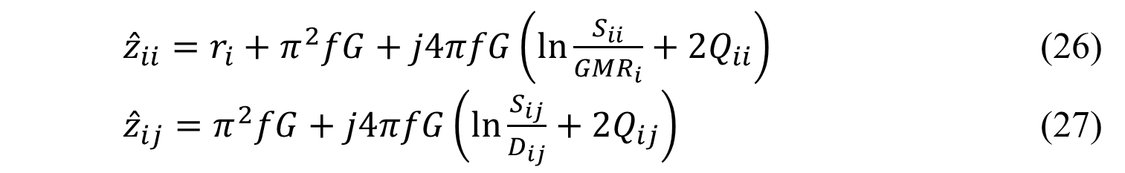
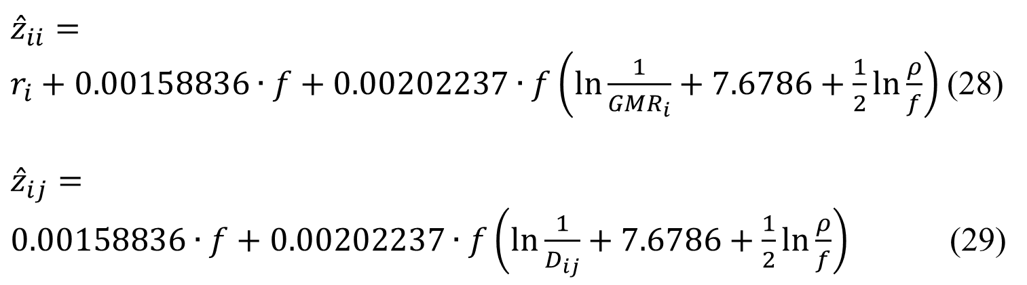
Modified Carson’s Equations: Derivation
Substitute expressions for ${ P}_{ij}$ and $ω=2πf:$
${\hat{z}}_{ii}=r_{i}+π^{2}fG+j4πfG\left(\ln{\frac{S_{ii}}{GMR_{i}}}+2Q_{ii}\right)$ (26)
${\hat{z}}_{ij}=π^{2}fG+j4πfG\left(\ln{\frac{S_{ij}}{D_{ij}}}+2Q_{ij}\right)$ (27)
Now substitute our expression for $2Q_{ij}$and values $π$and $G$:
${\hat{z}}_{ii}=r_{i}+0.00158836∙f+0.00202237∙f\left(\ln{\frac{1}{GMR_{i}}}+7.6786+\frac{1}{2}\ln{\frac{ρ}{f}}\right)$(28)
$${\hat{z}}_{ij}=$$
$0.00158836∙f+0.00202237∙f\left(\ln{\frac{1}{D_{ij}}}+7.6786+\frac{1}{2}\ln{\frac{ρ}{f}}\right)$ (29)

Slide 26
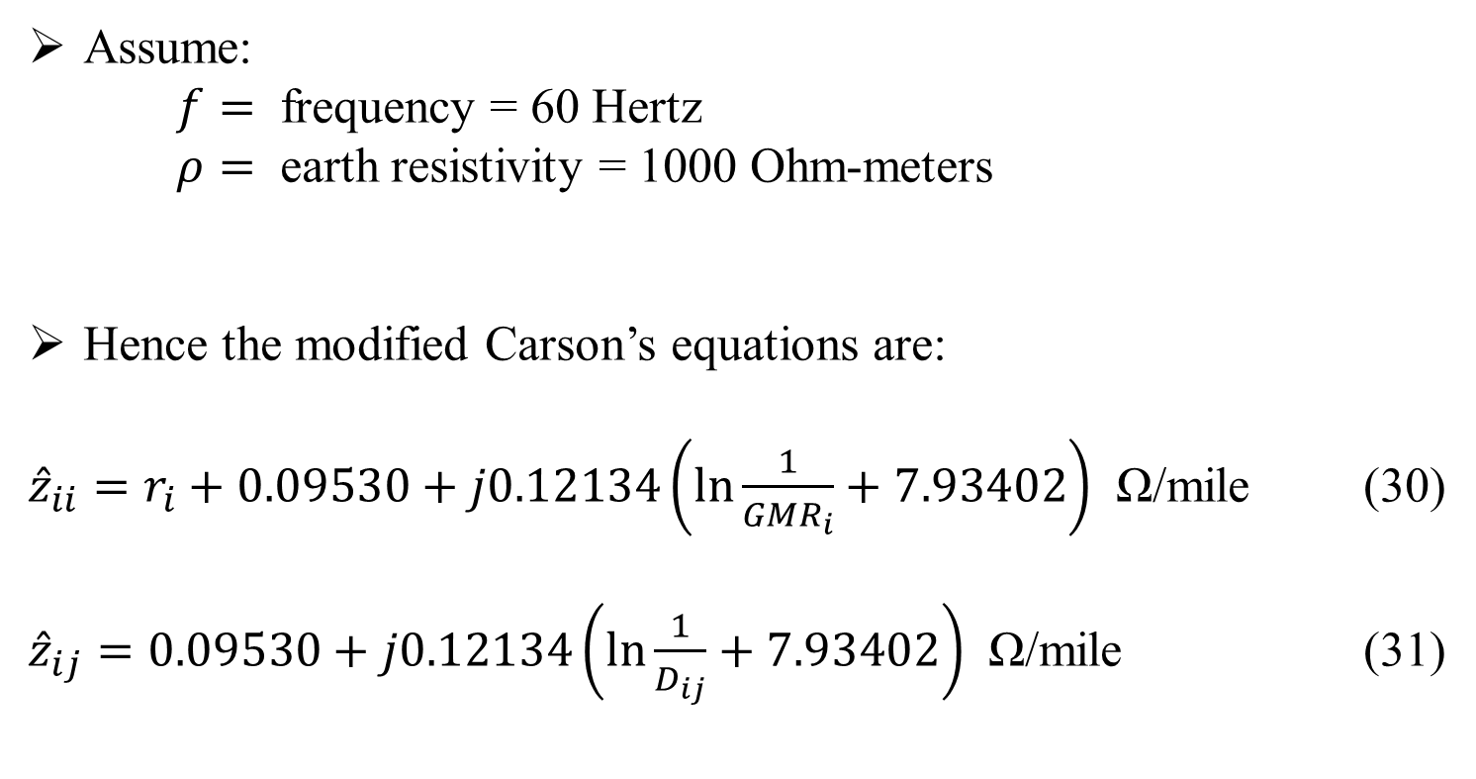
Series impedance of Overhead Lines (Contd…)
Modified Carson’s Equations
Assume:
$f=$ frequency = 60 Hertz
$ρ=$ earth resistivity = 1000 Ohm-meters
Hence the modified Carson’s equations are:
${\hat{z}}_{ii}=r_{i}+0.09530+j0.12134\left(\ln{\frac{1}{{GMR}_{i}}+7.93402}\right)$ Ω/mile (30)
${\hat{z}}_{ij}=0.09530+j0.12134\left(\ln{\frac{1}{D_{ij}}}+7.93402\right)$ Ω/mile (31)

Slide 27
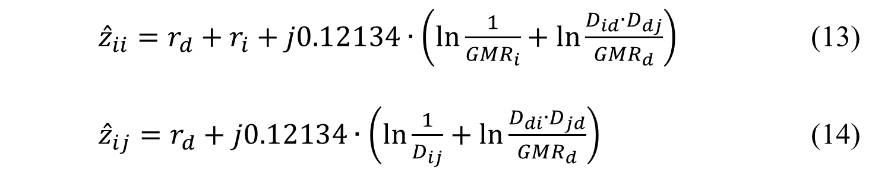
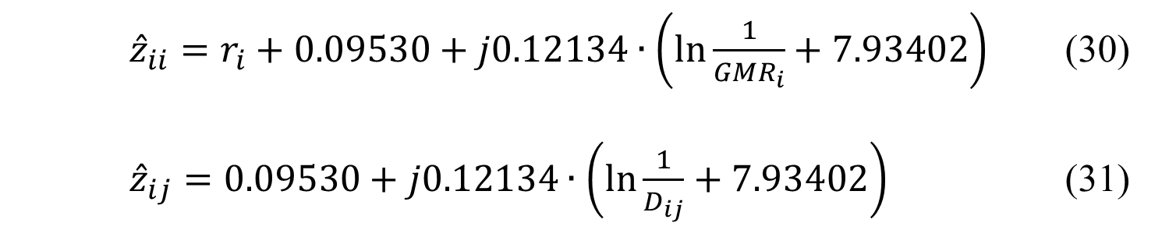
Series impedance of Overhead Lines (Contd…)
Comparing Equations
Primitive Impedance:
${\hat{z}}_{ii}=r_{d}+r_{i}+j0.12134∙\left(\ln{\frac{1}{GMR_{i}}}+\ln{\frac{D_{id}∙D_{dj}}{GMR_{d}}}\right)$ (13)
${\hat{z}}_{ij}=r_{d}+j0.12134∙\left(\ln{\frac{1}{D_{ij}}}+\ln{\frac{D_{di}∙D_{jd}}{GMR_{d}}}\right)$ (14)
Modified Carson’s:
${\hat{z}}_{ii}=r_{i}+0.09530+j0.12134∙\left(\ln{\frac{1}{{GMR}_{i}}}+7.93402\right)$ (30)
${\hat{z}}_{ij}=0.09530+j0.12134∙\left(\ln{\frac{1}{D_{ij}}}+7.93402\right)$ (31)

Slide 28
Part 1: Overhead Lines
Series impedance of Overhead Lines
Transposed Three-phase Lines
Untransposed Distribution Lines
Carson’s Equations
Modified Carson’s Equations
Primitive Impedance Matrix for Overhead Lines
Phase Impedance Matrix for Overhead Lines
Sequence Impedances
Parallel Overhead Distribution Lines
Shunt Admittance of Overhead Parallel Lines
General Voltage Drop Equation

Slide 29
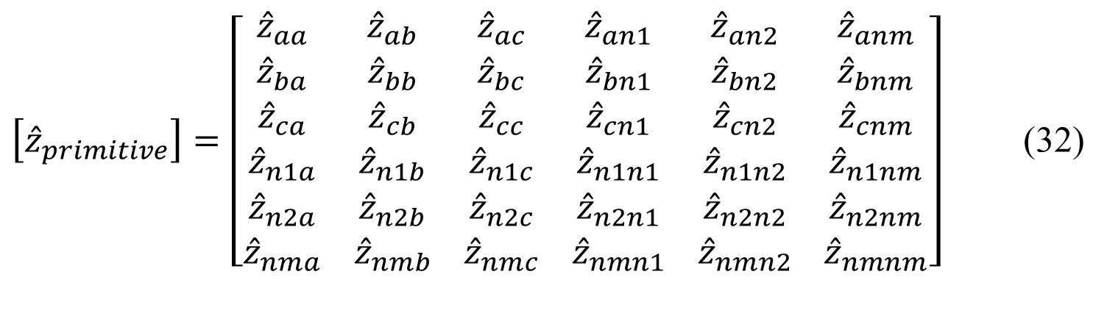
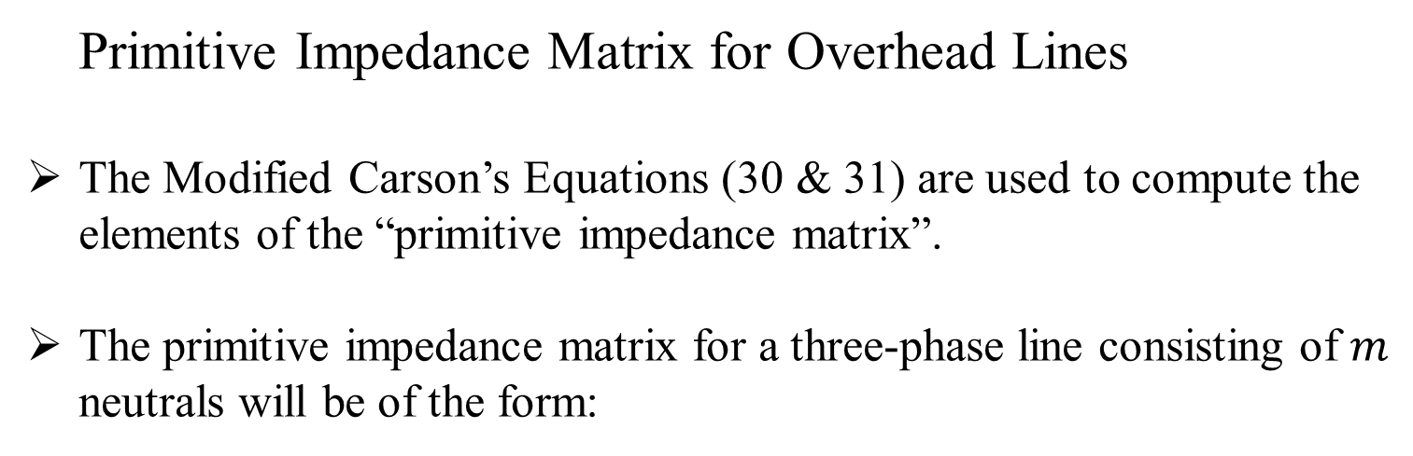
Series impedance of Overhead Lines (Contd…)
Primitive Impedance Matrix for Overhead Lines
The Modified Carson’s Equations (30 & 31) are used to compute the elements of the “primitive impedance matrix”.
The primitive impedance matrix for a three-phase line consisting of $m$ neutrals will be of the form:
$\left[{\hat{z}}_{primitive}\right]=\left[\begin{matrix}{\hat{z}}_{aa} \\ {\hat{z}}_{ba} \\ \begin{matrix}{\hat{z}}_{ca} \\ {\hat{z}}_{n1a} \\ \begin{matrix}{\hat{z}}_{n2a} \\ {\hat{z}}_{nma}\end{matrix}\end{matrix}\end{matrix} \begin{matrix}{\hat{z}}_{ab} \\ {\hat{z}}_{bb} \\ \begin{matrix}{\hat{z}}_{cb} \\ {\hat{z}}_{n1b} \\ \begin{matrix}{\hat{z}}_{n2b} \\ {\hat{z}}_{nmb}\end{matrix}\end{matrix}\end{matrix} \begin{matrix}{\hat{z}}_{ac} \\ {\hat{z}}_{bc} \\ \begin{matrix}{\hat{z}}_{cc} \\ {\hat{z}}_{n1c} \\ \begin{matrix}{\hat{z}}_{n2c} \\ {\hat{z}}_{nmc}\end{matrix}\end{matrix}\end{matrix} \begin{matrix}{\hat{z}}_{an1} \\ {\hat{z}}_{bn1} \\ \begin{matrix}{\hat{z}}_{cn1} \\ {\hat{z}}_{n1n1} \\ \begin{matrix}{\hat{z}}_{n2n1} \\ {\hat{z}}_{nmn1}\end{matrix}\end{matrix}\end{matrix} \begin{matrix}{\hat{z}}_{an2} \\ {\hat{z}}_{bn2} \\ \begin{matrix}{\hat{z}}_{cn2} \\ {\hat{z}}_{n1n2} \\ \begin{matrix}{\hat{z}}_{n2n2} \\ {\hat{z}}_{nmn2}\end{matrix}\end{matrix}\end{matrix} \begin{matrix}{\hat{z}}_{anm} \\ {\hat{z}}_{bnm} \\ \begin{matrix}{\hat{z}}_{cnm} \\ {\hat{z}}_{n1nm} \\ \begin{matrix}{\hat{z}}_{n2nm} \\ {\hat{z}}_{nmnm}\end{matrix}\end{matrix}\end{matrix}\right]$ (32)

Slide 30
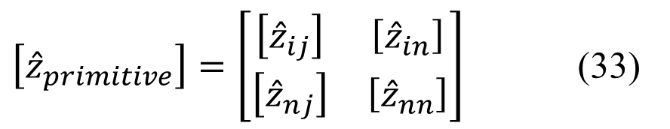
Series impedance of Overhead Lines (Contd…)
Primitive Impedance Matrix for Overhead Lines
In partitioned form, Equation (32) becomes:
$\left[{\hat{z}}_{primitive}\right]=\left[\begin{matrix}\left[{\hat{z}}_{ij}\right] & \left[{\hat{z}}_{in}\right] \\ \left[{\hat{z}}_{nj}\right] & \left[{\hat{z}}_{nn}\right]\end{matrix}\right]$ (33)

Slide 31
Part 1: Overhead Lines
Series impedance of Overhead Lines
Transposed Three-phase Lines
Untransposed Distribution Lines
Carson’s Equations
Modified Carson’s Equations
Primitive Impedance Matrix for Overhead Lines
Phase Impedance Matrix for Overhead Lines
Sequence Impedances
Parallel Overhead Distribution Lines
Shunt Admittance of Overhead Parallel Lines
General Voltage Drop Equation

Slide 32
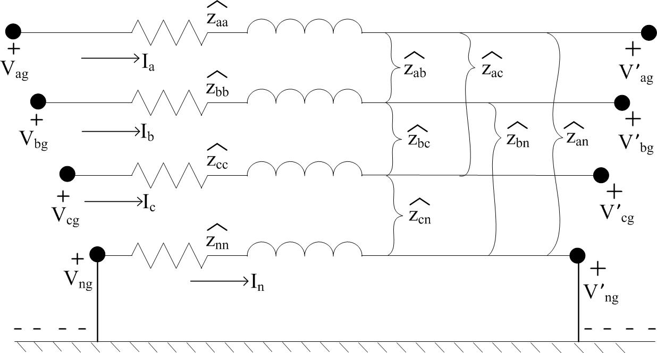
Series impedance of Overhead Lines (Contd…)
Phase Impedance Matrix for Overhead Lines
For most applications, the primitive impedance matrix needs to be reduced to a 3X3 “phase frame” matrix consisting of the self and mutual equivalent impedances for the three phases. Figure 5.0 shows a four-wire grounded neutral line segment
Figure 5.0

Slide 33
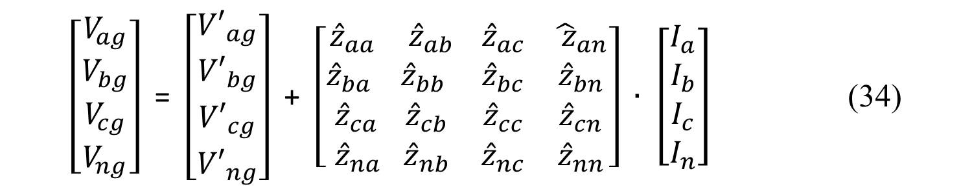
Series impedance of Overhead Lines (Contd…)
Phase Impedance Matrix for Overhead Lines (Contd…)
Figure 5.0
$\left[\begin{matrix}V_{ag} \\ \begin{matrix}V_{bg} \\ V_{cg} \\ V_{ng}\end{matrix}\end{matrix}\right]$ = $\left[\begin{matrix}{V′}_{ag} \\ \begin{matrix}{V′}_{bg} \\ {V′}_{cg} \\ {V′}_{ng}\end{matrix}\end{matrix}\right]$ + $\left[\begin{matrix}{\hat{z}}_{aa} \\ {\hat{z}}_{ba} \\ \begin{matrix}{\hat{z}}_{ca} \\ {\hat{z}}_{na }\end{matrix}\end{matrix}\begin{matrix}{\hat{z}}_{ab } \\ {\hat{z}}_{bb} \\ \begin{matrix}{\hat{z}}_{cb} \\ {\hat{z}}_{nb}\end{matrix} \end{matrix}\begin{matrix}{\hat{z}}_{ac} \\ {\hat{z}}_{bc} \\ \begin{matrix}{\hat{z}}_{cc} \\ {\hat{z}}_{nc}\end{matrix}\end{matrix} \begin{matrix}{\hat{ z}}_{an} \\ {\hat{z}}_{bn} \\ \begin{matrix}{\hat{z}}_{cn} \\ {\hat{z}}_{nn}\end{matrix}\end{matrix}\right] ∙$ $\left[\begin{matrix}I_{a} \\ I_{b} \\ \begin{matrix}I_{c} \\ I_{n}\end{matrix}\end{matrix}\right]$ (34)

Slide 34
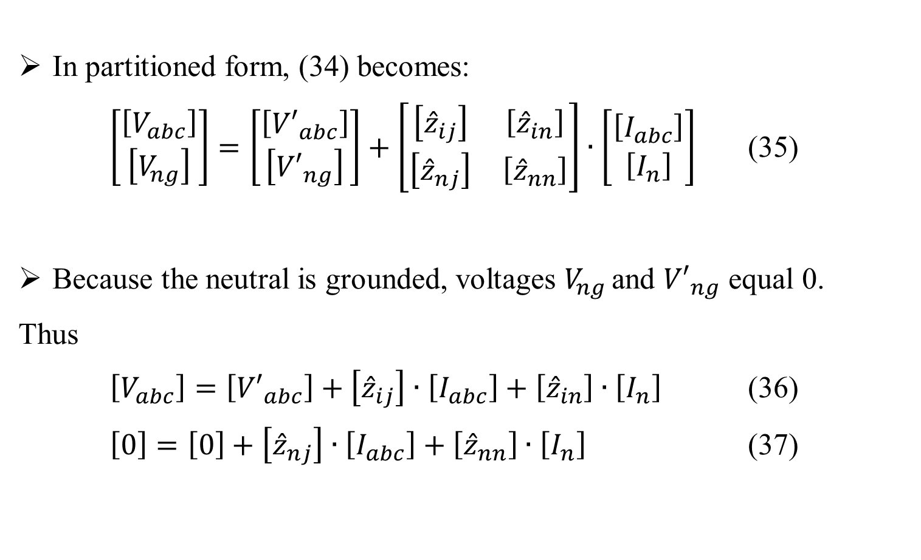
Series impedance of Overhead Lines (Contd…)
Phase Impedance Matrix for Overhead Lines
One standard method of reduction is the “Kron” reduction. The Kron reduction method applies KVL to the circuit.
In partitioned form, (34) becomes:
$\left[\begin{matrix}\left[V_{abc}\right] \\ \left[V_{ng}\right]\end{matrix}\right]=\left[\begin{matrix}\left[{V′}_{abc}\right] \\ \left[{V′}_{ng}\right]\end{matrix}\right]+\left[\begin{matrix}\left[{\hat{z}}_{ij}\right] & \left[{\hat{z}}_{in}\right] \\ \left[{\hat{z}}_{nj}\right] & \left[{\hat{z}}_{nn}\right]\end{matrix}\right]∙\left[\begin{matrix}\left[I_{abc}\right] \\ \left[I_{n}\right]\end{matrix}\right]$ (35)
Because the neutral is grounded, voltages $V_{ng }$and ${V′}_{ng}$ equal 0.
Thus
$\left[V_{abc}\right]=\left[{V′}_{abc}\right]+\left[{\hat{z}}_{ij}\right]∙\left[I_{abc}\right]+\left[{\hat{z}}_{in}\right]∙\left[I_{n}\right]$ (36)
$\left[0\right]=\left[0\right]+\left[{\hat{z}}_{nj}\right]∙\left[I_{abc}\right]+\left[{\hat{z}}_{nn}\right]∙\left[I_{n}\right]$ (37)

Slide 35
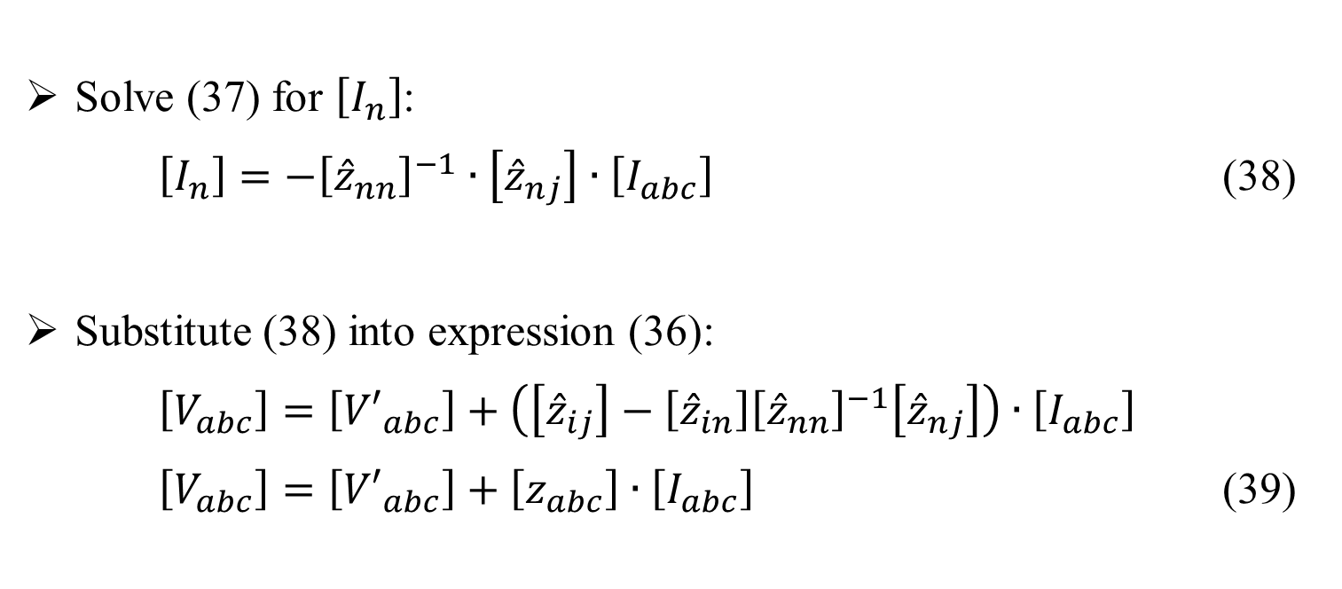
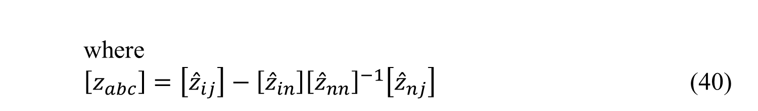
Series impedance of Overhead Lines (Contd…)
Phase Impedance Matrix for Overhead Lines
Solve (37) for $\left[I_{n}\right]$:
$\left[I_{n}\right]=−{\left[{\hat{z}}_{nn}\right]}^{−1}∙\left[{\hat{z}}_{nj}\right]∙\left[I_{abc}\right]$ (38)
Substitute (38) into expression (36):
$\left[V_{abc}\right]=\left[{V′}_{abc}\right]+\left(\left[{\hat{z}}_{ij}\right]−\left[{\hat{z}}_{in}\right]{\left[{\hat{z}}_{nn}\right]}^{−1}\left[{\hat{z}}_{nj}\right]\right)∙\left[I_{abc}\right]$
$\left[V_{abc}\right]=\left[{V′}_{abc}\right]+\left[z_{abc}\right]∙\left[I_{abc}\right]$ (39)
where
$\left[z_{abc}\right]=\left[{\hat{z}}_{ij}\right]−\left[{\hat{z}}_{in}\right]{\left[{\hat{z}}_{nn}\right]}^{−1}\left[{\hat{z}}_{nj}\right]$ (40)

Slide 36
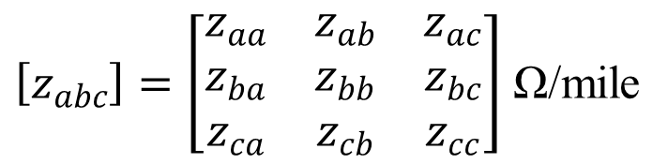
Series impedance of Overhead Lines (Contd…)
Phase Impedance Matrix for Overhead Lines
After having applied the Kron reduction technique, the final phase impedance matrix becomes:
$\left[z_{abc}\right]=\left[\begin{matrix}z_{aa} & z_{ab} & z_{ac} \\ z_{ba} & z_{bb} & z_{bc} \\ z_{ca} & z_{cb} & z_{cc}\end{matrix}\right]$ Ω/mile
(41)

Slide 37
Series impedance of Overhead Lines (Contd…)
Phase Impedance Matrix for Overhead Lines
The phase impedance matrix for a three-wire delta line is determined by the application of Carson’s equations without the Kron reduction step.
The phase impedance matrix can be used to accurately determine the voltage drops on the feeder line segments once the currents have been determined.
Since no approximations (transpositions for example) have been made regarding the spacing between conductors, the effect of the mutual coupling between the phases is accurately taken into account.

Slide 38
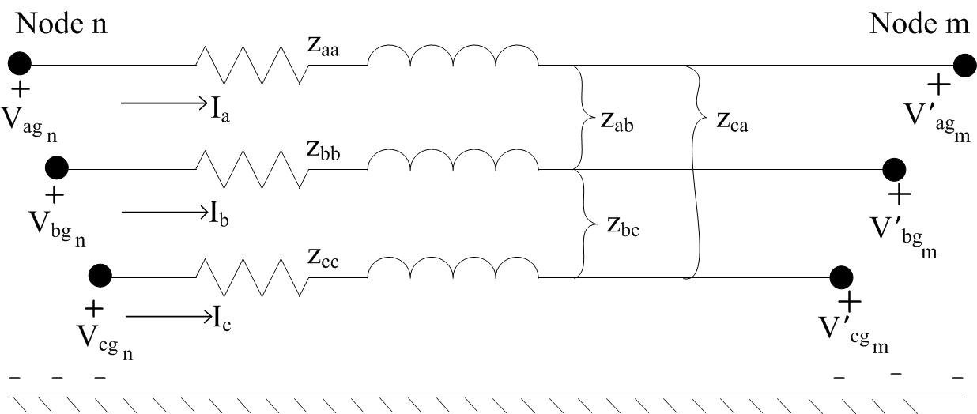
Series impedance of Overhead Lines (Contd…)
Phase Impedance Matrix for Overhead Lines
The application of the Modified Carson’s equations and the phase frame matrix lead to the most accurate model of a line segment as shown in Figure 6.0.
Figure 6.0

Slide 39
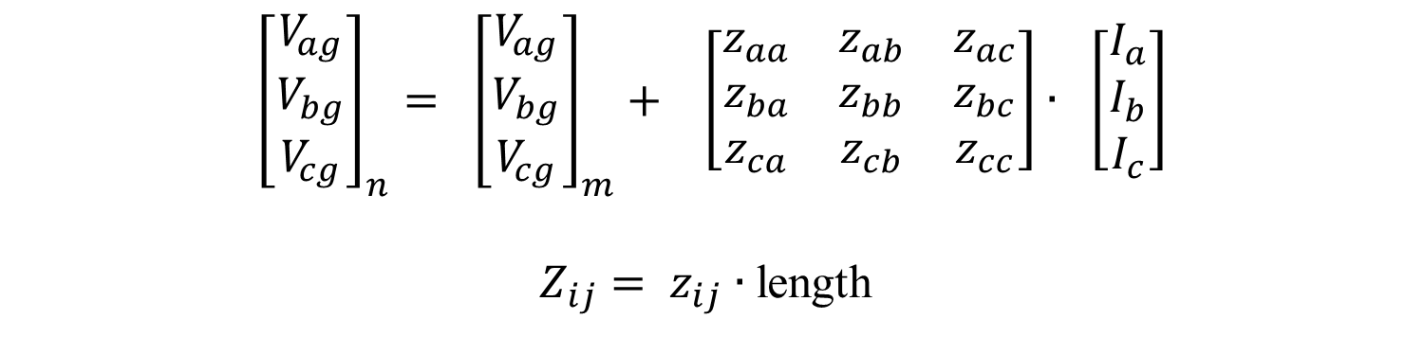
Series impedance of Overhead Lines (Contd…)
Phase Impedance Matrix for Overhead Lines
$${\left[\begin{matrix}V_{ag} \\ V_{bg} \\ V_{cg}\end{matrix}\right]}_{n}= {\left[\begin{matrix}V_{ag} \\ V_{bg} \\ V_{cg}\end{matrix}\right]}_{m}+ \left[\begin{matrix}z_{aa} & z_{ab} & z_{ac} \\ z_{ba} & z_{bb} & z_{bc} \\ z_{ca} & z_{cb} & z_{cc}\end{matrix}\right]∙ \left[\begin{matrix}I_{a} \\ I_{b} \\ I_{c}\end{matrix}\right]$$
$Z_{ij}= z_{ij}∙$length

Slide 40
Part 1: Overhead Lines
Series impedance of Overhead Lines
Transposed Three-phase Lines
Untransposed Distribution Lines
Carson’s Equations
Modified Carson’s Equations
Primitive Impedance Matrix for Overhead Lines
Phase Impedance Matrix for Overhead Lines
Sequence Impedances
Parallel Overhead Distribution Lines
Shunt Admittance of Overhead Parallel Lines
General Voltage Drop Equation

Slide 41
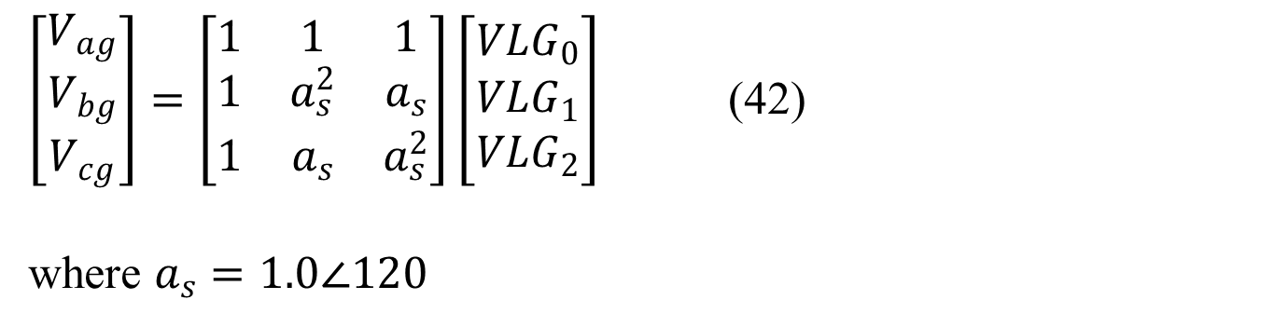
Series impedance of Overhead Lines (Contd…)
Sequence Impedances
Many times the analysis of a feeder will use only the positive and zero sequence impedances for the line segments. There are 2 methods for obtaining these impedances.
The first method uses the Modified Carson’s Equations and the Kron reduction to obtain the phase impedance matrix.
The definition of line-to-ground phase voltages as a function of the line-to-ground sequence voltages is given by
$\left[\begin{matrix}V_{ag} \\ V_{bg} \\ V_{cg}\end{matrix}\right]=\left[\begin{matrix}1 & 1 & 1 \\ 1 & a_{s}^{2} & a_{s} \\ 1 & a_{s} & a_{s}^{2}\end{matrix}\right]\left[\begin{matrix}{VLG}_{0} \\ {VLG}_{1} \\ {VLG}_{2}\end{matrix}\right]$ (42)
where $a_{s}=1.0∠120$

Slide 42
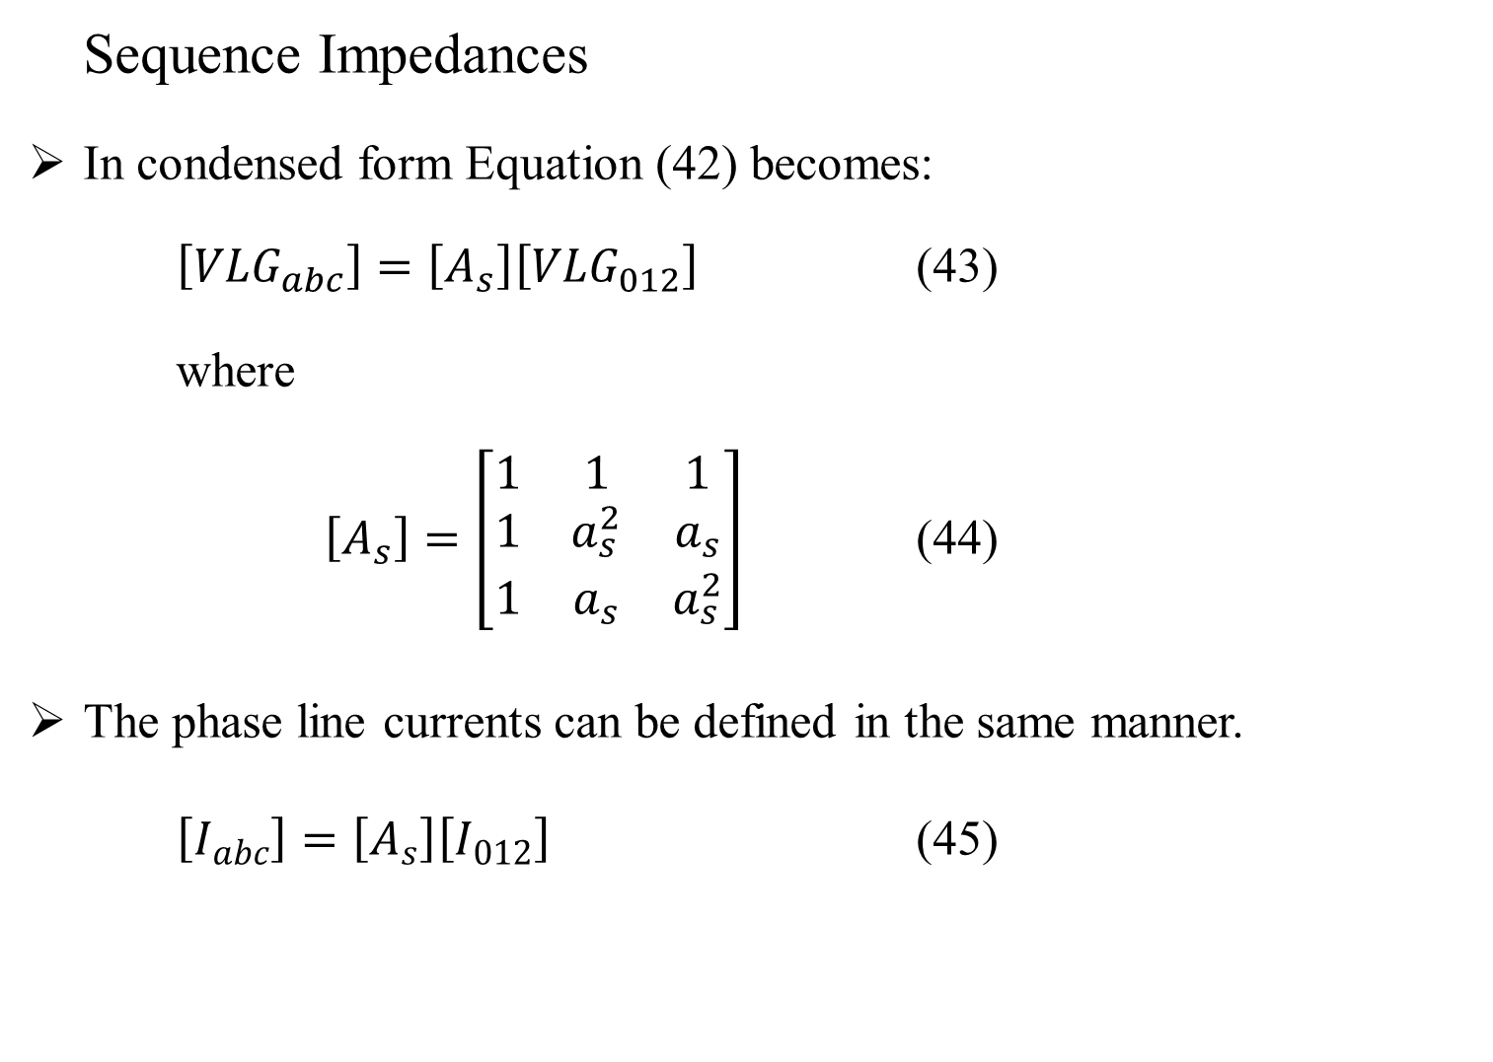
Series impedance of Overhead Lines (Contd…)
Sequence Impedances
In condensed form Equation (42) becomes:
$\left[{VLG}_{abc}\right]=\left[A_{s}\right]\left[{VLG}_{012}\right]$ (43)
where
$\left[A_{s}\right]=\left[\begin{matrix}1 & 1 & 1 \\ 1 & a_{s}^{2} & a_{s} \\ 1 & a_{s} & a_{s}^{2}\end{matrix}\right]$ (44)
The phase line currents can be defined in the same manner.
$\left[I_{abc}\right]=\left[A_{s}\right]\left[I_{012}\right]$ (45)

Slide 43
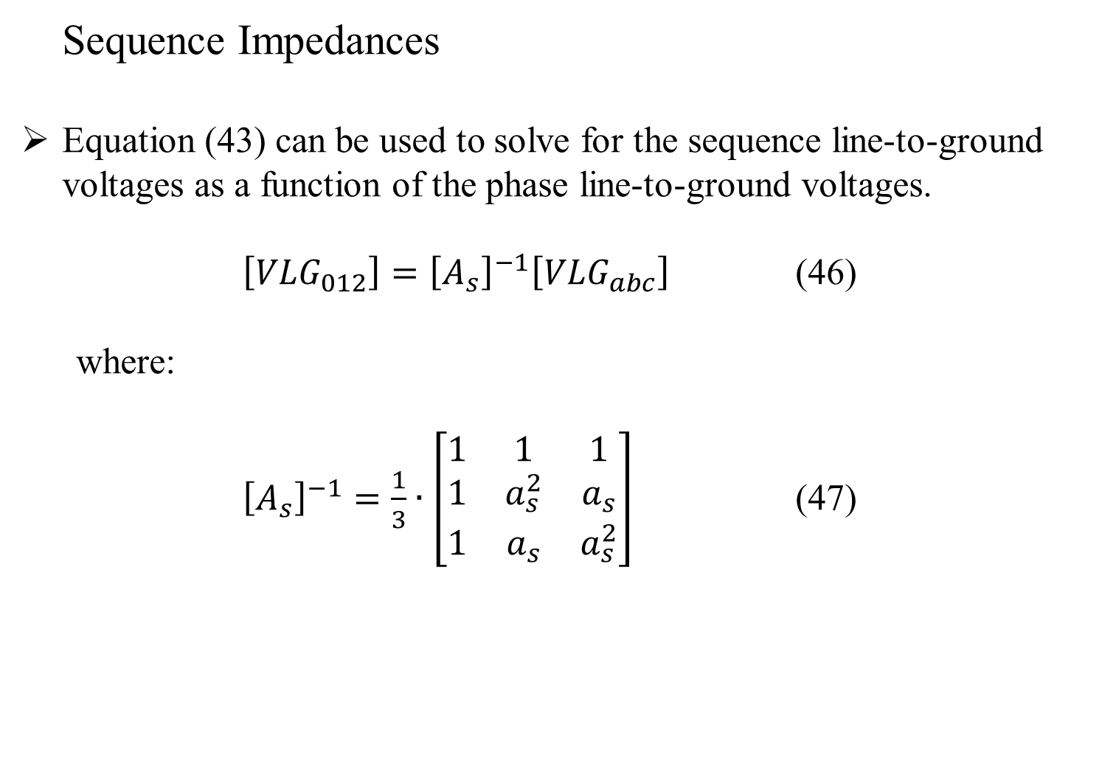
Series impedance of Overhead Lines (Contd…)
Sequence Impedances
Equation (43) can be used to solve for the sequence line-to-ground voltages as a function of the phase line-to-ground voltages.
$\left[{VLG}_{012}\right]={\left[A_{s}\right]}^{−1}\left[{VLG}_{abc}\right]$ (46)
where:
${\left[A_{s}\right]}^{−1}=\frac{1}{3}∙\left[\begin{matrix}1 & 1 & 1 \\ 1 & a_{s}^{2} & a_{s} \\ 1 & a_{s} & a_{s}^{2}\end{matrix}\right]$ (47)

Slide 44
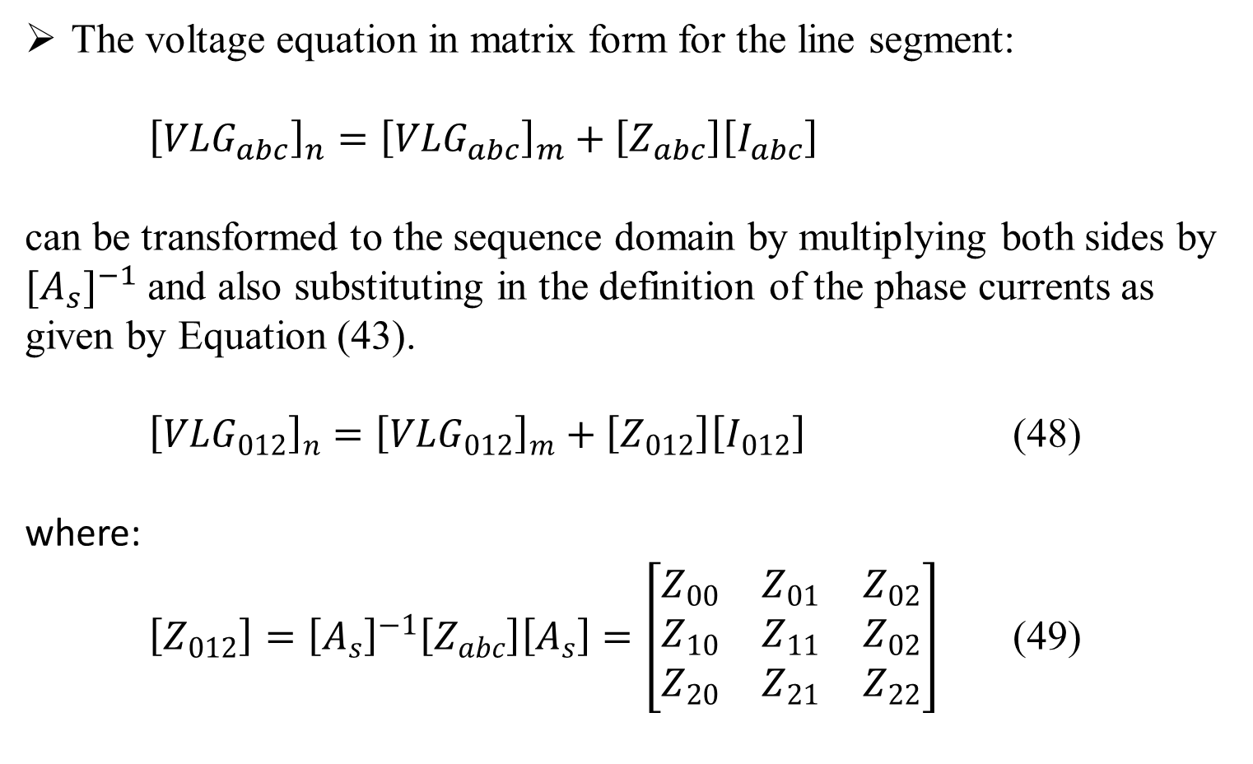
Series impedance of Overhead Lines (Contd…)
Sequence Impedances
The voltage equation in matrix form for the line segment:
${\left[{VLG}_{abc}\right]}_{n}={\left[{VLG}_{abc}\right]}_{m}+\left[Z_{abc}\right]\left[I_{abc}\right]$
can be transformed to the sequence domain by multiplying both sides by ${[A_{s}]}^{−1}$ and also substituting in the definition of the phase currents as given by Equation (43).
${\left[{VLG}_{012}\right]}_{n}={\left[{VLG}_{012}\right]}_{m}+\left[Z_{012}\right]\left[I_{012}\right]$ (48)
where:
$\left[Z_{012}\right]={\left[A_{s}\right]}^{−1}\left[Z_{abc}\right]\left[A_{s}\right]=\left[\begin{matrix}Z_{00} & Z_{01} & Z_{02} \\ Z_{10} & Z_{11} & Z_{02} \\ Z_{20} & Z_{21} & Z_{22}\end{matrix}\right]$ (49)

Slide 45
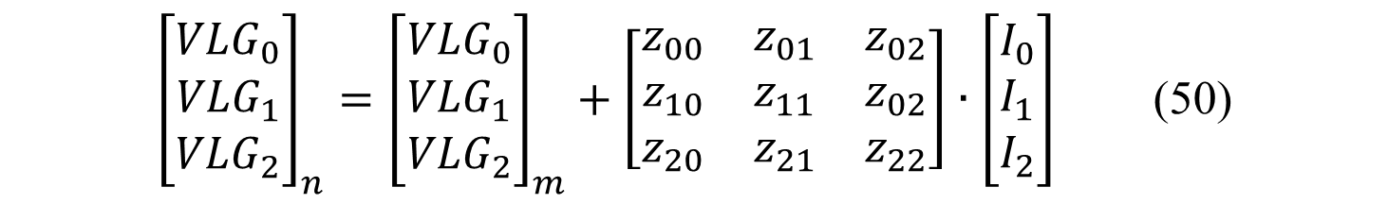
Series impedance of Overhead Lines (Contd…)
Sequence Impedances
Equation (48) in expanded form is given by
${\left[\begin{matrix}{VLG}_{0} \\ {VLG}_{1} \\ {VLG}_{2}\end{matrix}\right]}_{n}={\left[\begin{matrix}{VLG}_{0} \\ {VLG}_{1} \\ {VLG}_{2}\end{matrix}\right]}_{m}+\left[\begin{matrix}z_{00} & z_{01} & z_{02} \\ z_{10} & z_{11} & z_{02} \\ z_{20} & z_{21} & z_{22}\end{matrix}\right]∙\left[\begin{matrix}I_{0} \\ I_{1} \\ I_{2}\end{matrix}\right]$ (50)
Equation (49) is the defining equation for converting phase impedances to sequence impedances. In equation (49), the diagonal terms of the matrix are the sequence impedances of the line such that:

Slide 46
Series impedance of Overhead Lines (Contd…)
Sequence Impedances
<Kevin’s example of sequential components not being equal to phase components. In any commercial tool, often diagonal components are ignored>

Slide 47
Series impedance of Overhead Lines (Contd…)
Sequence Impedances
The off-diagonal terms of Equation (49) represent the mutual coupling between sequences.
If the lines were transposed, these off-diagonal terms would be zero. This will generally be true for off-diagonal terms.
For transposed lines, the phase impedance matrix is modified so the three diagonal terms are equal, and all of the off-diagonal terms are equal.
Usually, the procedure is to set the three diagonal terms of the phase impedance matrix equal to the average of the diagonal terms of Equation (41) and the off-diagonal terms equal to the average of the off-diagonal terms of Equation (41).

Slide 48
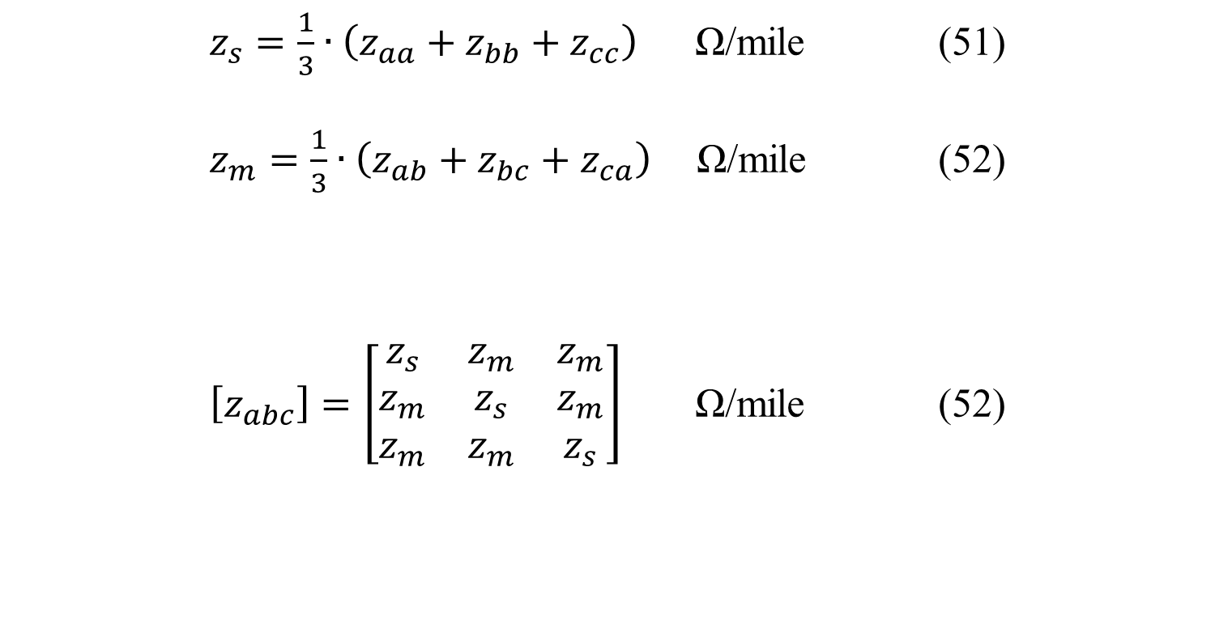
Series impedance of Overhead Lines (Contd…)
Sequence Impedances for transposed lines
Self and Mutual Impedance defined as:
$z_{s}=\frac{1}{3}∙\left(z_{aa}+z_{bb}+z_{cc}\right)$ Ω/mile (51)
$z_{m}=\frac{1}{3}∙\left(z_{ab}+z_{bc}+z_{ca}\right)$ Ω/mile (52)
$\left[z_{abc}\right]=\left[\begin{matrix}z_{s} & z_{m} & z_{m} \\ z_{m} & z_{s} & z_{m} \\ z_{m} & z_{m} & z_{s}\end{matrix}\right]$ Ω/mile (52)
Phase Impedance matrix:

Slide 49
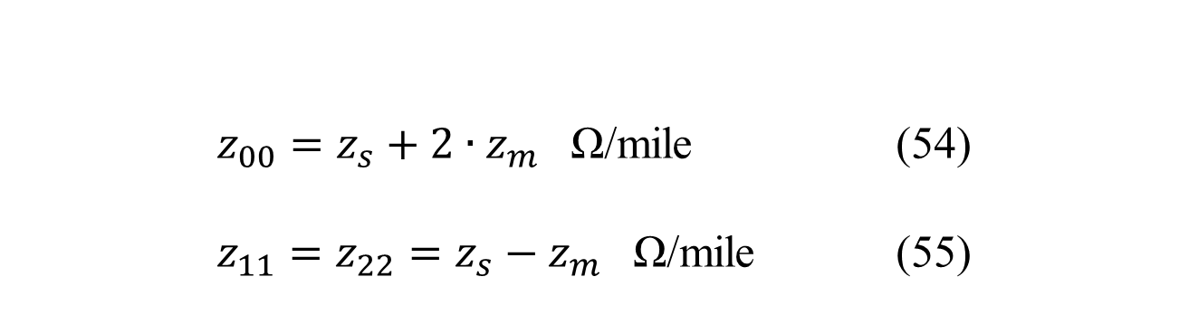
Series impedance of Overhead Lines (Contd…)
Sequence Impedances for transposed lines
Determine Sequence Impedances:
$z_{00}=z_{s}+2∙z_{m}$ Ω/mile (54)
$z_{11}=z_{22}=z_{s}−z_{m}$ Ω/mile (55)

Slide 50
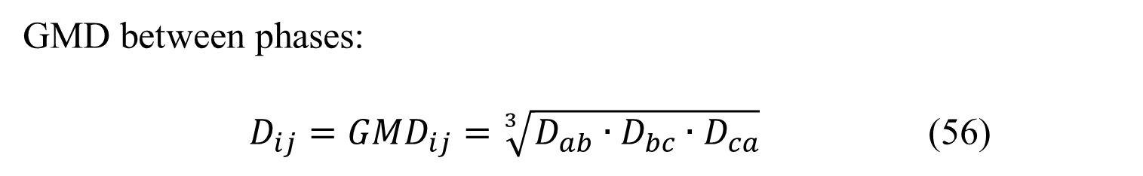
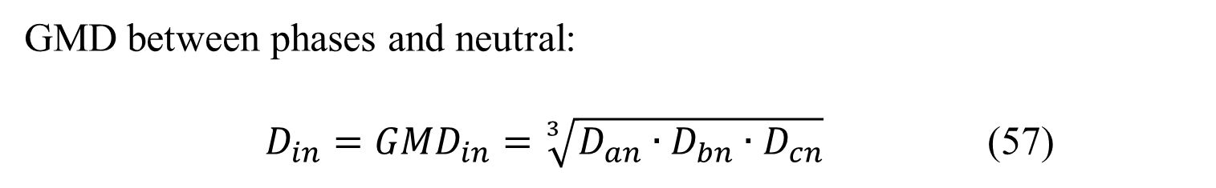
Series impedance of Overhead Lines (Contd…)
Sequence Impedances
A second method that is commonly used to determine the sequence impedances directly is to employ the concept of Geometric Mean Distances (GMD).
GMD between phases:
$D_{ij}=GMD_{ij}=\sqrt[3]{D_{ab}∙D_{bc}∙D_{ca}}$ (56)
GMD between phases and neutral:
$D_{in}=GMD_{in}=\sqrt[3]{D_{an}∙D_{bn}∙D_{cn}}$ (57)

Slide 51
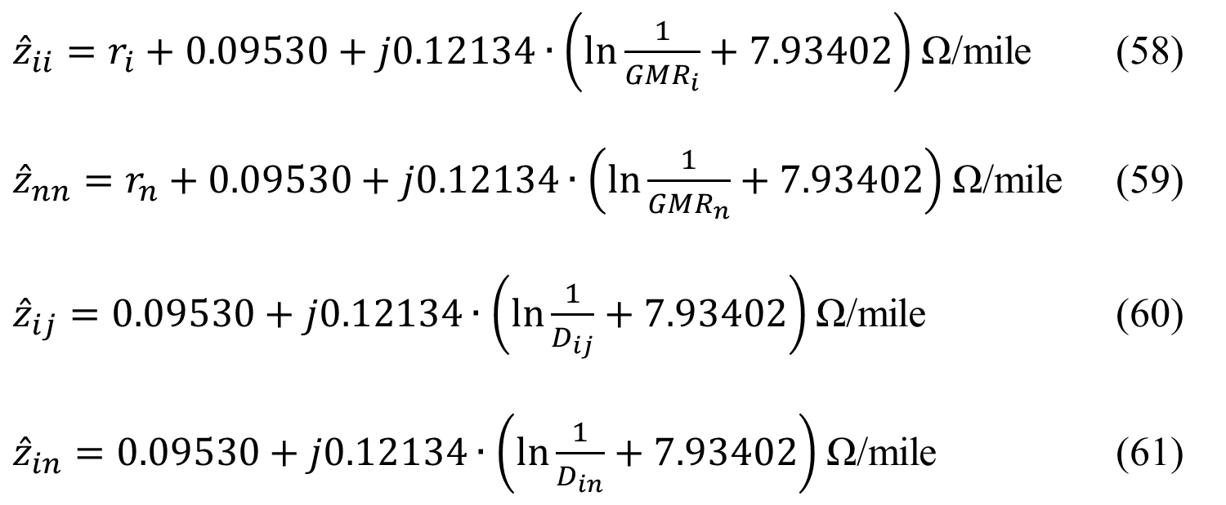
Series impedance of Overhead Lines (Contd…)
Sequence Impedances
The above GMD’s are used in the Modified Carson Equations, resulting in:
${\hat{z}}_{ii}=r_{i}+0.09530+j0.12134∙\left(\ln{\frac{1}{{GMR}_{i}}}+7.93402\right)$ Ω/mile (58)
${\hat{z}}_{nn}=r_{n}+0.09530+j0.12134∙\left(\ln{\frac{1}{{GMR}_{n}}}+7.93402\right)$ Ω/mile (59)
${\hat{z}}_{ij}=0.09530+j0.12134∙\left(\ln{\frac{1}{D_{ij}}}+7.93402\right)$Ω/mile (60)
${\hat{z}}_{in}=0.09530+j0.12134∙\left(\ln{\frac{1}{D_{in}}}+7.93402\right)$ Ω/mile (61)

Slide 52
Part 1: Overhead Lines
Series impedance of Overhead Lines
Transposed Three-phase Lines
Untransposed Distribution Lines
Carson’s Equations
Modified Carson’s Equations
Primitive Impedance Matrix for Overhead Lines
Phase Impedance Matrix for Overhead Lines
Sequence Impedances
Parallel Overhead Distribution Lines
Shunt Admittance of Overhead Parallel Lines
General Voltage Drop Equation

Slide 53
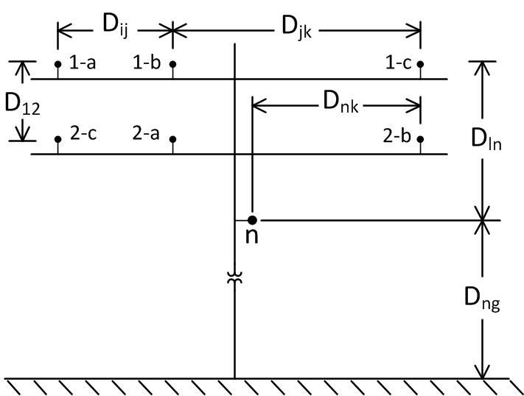
Series impedance of Overhead Lines
Parallel Overhead Lines
It is fairly common in a distribution system to find instances where two distribution lines are “physically” parallel.
The phase impedance matrix of parallel lines is computed from the application of Carson’s equations and the Kron reduction method.
Line 1
Line 2
Figure 7.0

Slide 54
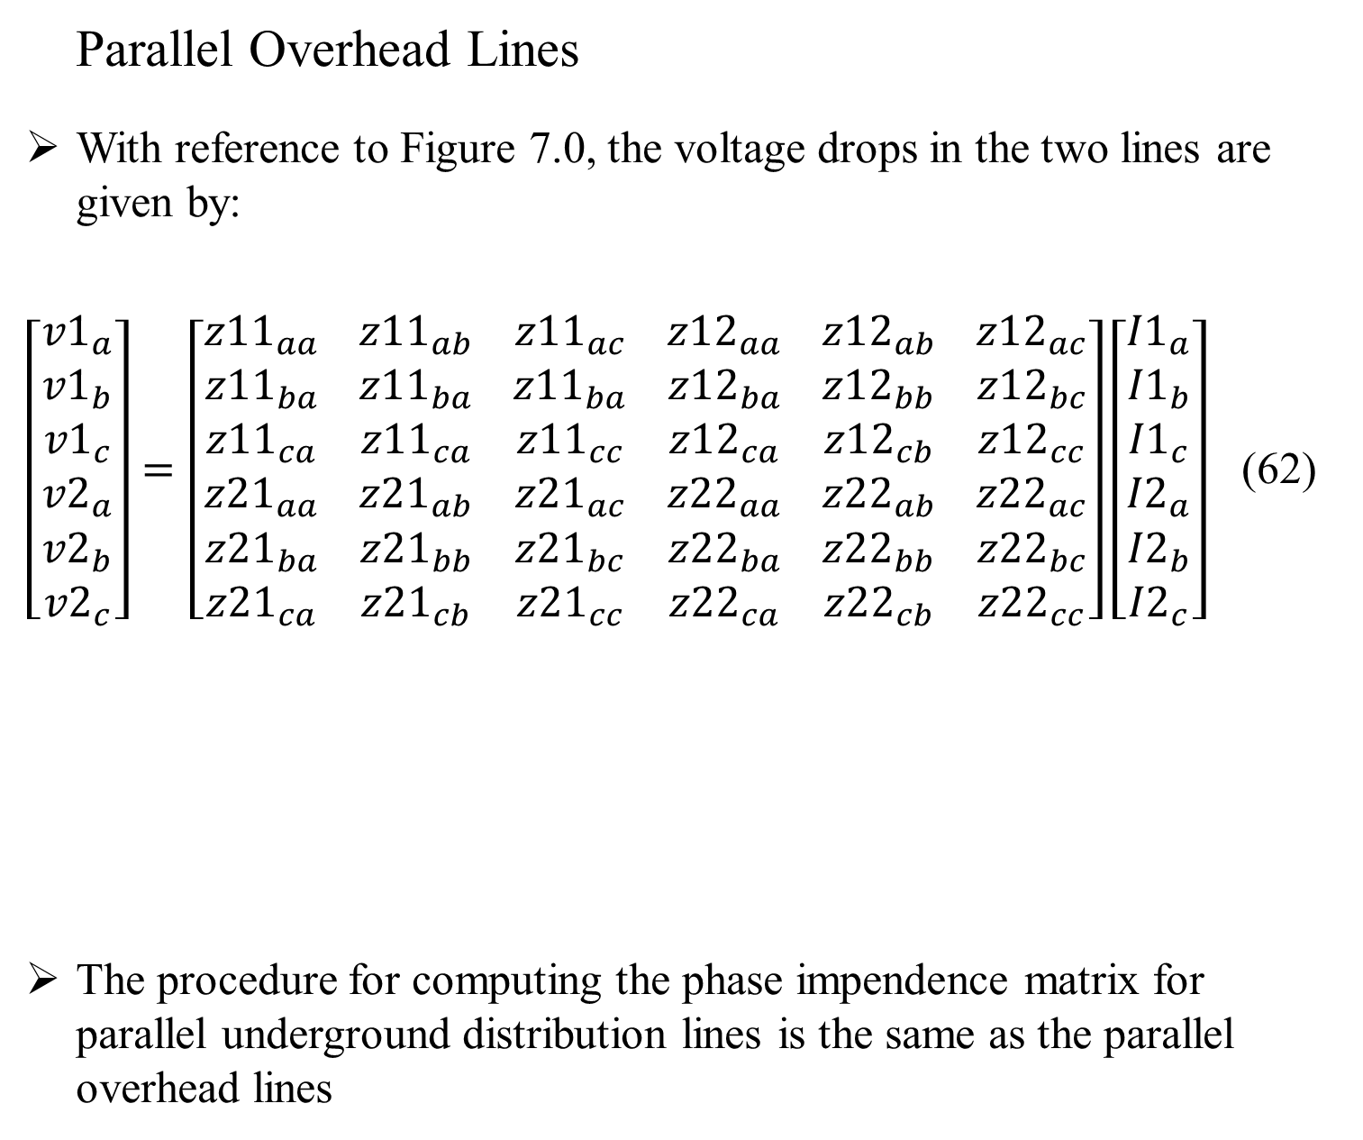
Series impedance of Overhead Lines
Parallel Overhead Lines
With reference to Figure 7.0, the voltage drops in the two lines are given by:
$\left[\begin{matrix}{v1}_{a} \\ {v1}_{b} \\ \begin{matrix}{v1}_{c} \\ {v2}_{a} \\ \begin{matrix}{v2}_{b} \\ {v2}_{c}\end{matrix}\end{matrix}\end{matrix}\right]=\left[\begin{matrix}{z11}_{aa} \\ {z11}_{ba} \\ \begin{matrix}{z11}_{ca} \\ {z21}_{aa} \\ \begin{matrix}{z21}_{ba} \\ {z21}_{ca}\end{matrix}\end{matrix}\end{matrix} \begin{matrix}{z11}_{ab} \\ {z11}_{ba} \\ \begin{matrix}{z11}_{ca} \\ {z21}_{ab} \\ \begin{matrix}{z21}_{bb} \\ {z21}_{cb}\end{matrix}\end{matrix}\end{matrix} \begin{matrix}{z11}_{ac} \\ {z11}_{ba} \\ \begin{matrix}{z11}_{cc} \\ {z21}_{ac} \\ \begin{matrix}{z21}_{bc} \\ {z21}_{cc}\end{matrix}\end{matrix}\end{matrix} \begin{matrix}{z12}_{aa} \\ {z12}_{ba} \\ \begin{matrix}{z12}_{ca} \\ {z22}_{aa} \\ \begin{matrix}{z22}_{ba} \\ {z22}_{ca}\end{matrix}\end{matrix}\end{matrix} \begin{matrix}{z12}_{ab} \\ {z12}_{bb} \\ \begin{matrix}{z12}_{cb} \\ {z22}_{ab} \\ \begin{matrix}{z22}_{bb} \\ {z22}_{cb}\end{matrix}\end{matrix}\end{matrix} \begin{matrix}{z12}_{ac} \\ {z12}_{bc} \\ \begin{matrix}{z12}_{cc} \\ {z22}_{ac} \\ \begin{matrix}{z22}_{bc} \\ {z22}_{cc}\end{matrix}\end{matrix}\end{matrix}\right]\left[\begin{matrix}{I1}_{a} \\ {I1}_{b} \\ \begin{matrix}{I1}_{c} \\ {I2}_{a} \\ \begin{matrix}{I2}_{b} \\ {I2}_{c}\end{matrix}\end{matrix}\end{matrix}\right]$ (62)
The procedure for computing the phase impendence matrix for parallel underground distribution lines is the same as the parallel overhead lines

Slide 55
Part 1: Overhead Lines
Series impedance of Overhead Lines
Transposed Three-phase Lines
Untransposed Distribution Lines
Carson’s Equations
Modified Carson’s Equations
Primitive Impedance Matrix for Overhead Lines
Phase Impedance Matrix for Overhead Lines
Sequence Impedances
Parallel Overhead Distribution Lines
Shunt Admittance of Overhead Parallel Lines
General Voltage Drop Equation

Slide 56
Shunt Admittance of Overhead Parallel Lines
General Voltage Drop Equation
The shunt admittance of a line consists of the conductance and the capacitive susceptance.
The conductance is usually ignored because it is very small compared to the capacitive susceptance.
The capacitance of a line is the result of the potential difference between conductors

Slide 57
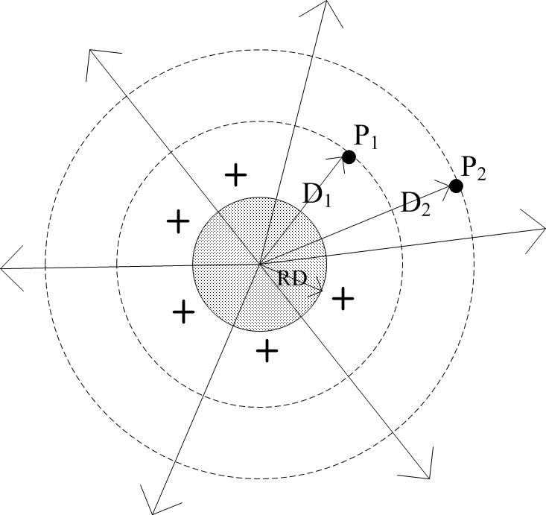
Shunt Admittance of Overhead Parallel Lines
Electric field of a charged round conductor
Figure 8.0

Slide 58
Shunt Admittance of Overhead Parallel Lines
Electric field of a charged round conductor
A charged conductor creates an electric field that emanates outward from the center of the conductor.
Lines of equipotential are created outward from the center of the conductor.
A difference of potential between two points is a result of the electric field of the charged conductor.
When the potential difference between two points is known, then the capacitance between the two points can be computed.

Slide 59
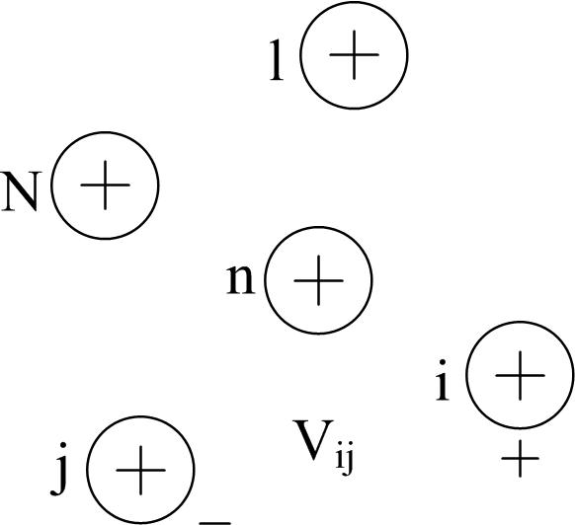

Shunt Admittance of Overhead Parallel Lines
General Voltage Drop Equation
Figure 9.0
$V_{ij}=\frac{1}{2πε}\sum_{n=1}^{N}{q_{n}}\ln{\frac{D_{nj}}{D_{ni}}}$ (63)

Slide 60
Part 1: Overhead Lines
Series impedance of Overhead Lines
Transposed Three-phase Lines
Untransposed Distribution Lines
Carson’s Equations
Modified Carson’s Equations
Primitive Impedance Matrix for Overhead Lines
Phase Impedance Matrix for Overhead Lines
Sequence Impedances
Parallel Overhead Distribution Lines
Shunt Admittance of Overhead Parallel Lines
General Voltage Drop Equation

Slide 61

Shunt Admittance of Overhead Parallel Lines
Definition of Terms
$ε=ε_{0}ε_{r}=$ permittivity of the medium
$ε_{0}=$ permittivity of free space $=8.85×{10}^{−12}μ$F/meter
$ε_{r}=$ relative permittivity of the medium
$q_{n}=$ charge density on conductor $n$ cb/meter
$D_{ni}=$ distance between conductor $n$ and conductor $i$ (ft.)
$D_{nj}=$ distance between conductor $n$ and conductor $j$ (ft.)
$D_{nn}=$ radius ($RD_{n}$) of conductor $n$

Slide 62

Shunt Admittance of Overhead Parallel Lines
Conductors and Images
Figure 10.0

Slide 63

Shunt Admittance of Overhead Parallel Lines
The method of conductors and their images is employed in the calculation of the shunt capacitance of overhead lines. This is the same concept that was used for calculating series impedances in the general application of Carson’s Equations.
$V_{ii} =\frac{1}{2πε}\left(q_{i}\ln{\frac{S_{ii}}{RD_{i}}+{q′}_{i}\ln{\frac{RD_{i}}{S_{ii}}+q_{j}\ln{\frac{S_{ij}}{D_{ij}}}}}+{q′}_{j}\ln{\frac{D_{ij}}{S_{ij}}}\right)$ (64)
when assuming:
${q′}_{i} =−q_{i}$
${q′}_{j} =−q_{j}$ (66)
$V_{ig}=\frac{1}{2πε}\left(q_{i}\ln{\frac{S_{ii}}{RD_{i}}+q_{j}\ln{\frac{S_{ij}}{D_{ij}}}}\right)$ (65)

Slide 64


Shunt Admittance of Overhead Parallel Lines
where
$S_{ii}=$ distance of the conductor $i$ to its image $i′$ (ft)
$S_{ij}=$ distance of the conductor $i$ to the image of conductor $j$ (ft)
$D_{ij}=$ distance of the conductor $i$ to conductor $j$ (ft)
${RD}_{i}=$ radius of conductor $i$ (ft)
The first step is to create the primitive potential coefficient matrix, where the elements of the primitive potential coefficient matrix are given by
${\hat{P}}_{ii}=11.17689\ln{\frac{S_{ii}}{{RD}_{i}}}$ mile/$μ$F (67)
${\hat{P}}_{ij}=11.17689\ln{\frac{S_{ij}}{D_{ij}}}$ mile/$μ$F (68)

Slide 65

Shunt Admittance of Overhead Parallel Lines
After reducing the primitive potential matrix through Kron reduction, we obtain the potential matrix $\left[P\right]$.
The shunt capacitance matrix is the inverse of the potential matrix.
$\left[C\right]={\left[P\right]}^{−1}$ (69)
The Shunt admittance matrix is given by
$\left[y\right]=jω∙\left[C\right]∙{10}^{−6}=\left[\begin{matrix}\left[y11\right] & \left[y12\right] \\ \left[y21\right] & \left[y22\right]\end{matrix}\right]S$ (70)
where $ω=2π∙frequency$

Slide 66
Part 2: Underground Lines
Underground lines
Series impedance of Underground Lines
Concentric Neutral Cable
Tape Shielded Cables
Shunt Admittance of Underground Lines
Concentric Neutral Cable
Tape Shielded Cables
Sequence Admittance
Parallel Underground Distribution Lines
Series impedance
Shunt Admittance

Slide 67
Part 2: Underground Lines
Underground lines
Series impedance of Underground Lines
Concentric Neutral Cable
Tape Shielded Cables
Shunt Admittance of Underground Lines
Concentric Neutral Cable
Tape Shielded Cables
Sequence Admittance
Parallel Underground Distribution Lines
Series impedance
Shunt Admittance

Slide 68

Series impedance of Underground Lines
Concentric Neutral Cable
Figure shows the detail of a concentric neutral cable
Figure 11.0

Slide 69

Series impedance of Underground Lines
Concentric Neutral Cable
In order to apply the Carson’s equations, the following data needs to be extracted from a table of underground cables. (Appendices A and B in the book)
$d_{c}=$ diameter of phase conductor (inches)
$d_{od}=$ nominal diameter over the concentric neutrals of the cable (inches)
$d_{s}=$ diameter of a concentric neutral strand (inches)
$GMR_{c}=$ geometric mean radius of the phase conductor (feet)
${GMR}_{s}=$ geometric mean radius of a neutral strand (feet)
$r_{c}=$ resistance of the phase conductor (Ω/mile)
$r_{s}=$ resistance of a solid neutral strand (Ω/mile)
$k=$ number of concentric neutral strands

Slide 70

Series impedance of Underground Lines
Concentric Neutral Cable
The GMR of the phase conductor and a neutral strand are obtained from the standard table of the conductor data (Appendix A).
The equivalent GMR of the concentric neutral is computed using the equation
${GMR}_{cn}=\sqrt[k]{{GMR}_{s}∙k∙R^{k−1}}$ ft (71)
where $R$is the radius of a circle passing through the center of the concentric neutral strands given by:
$R=\frac{d_{od}−d_{s}}{24}$ ft (72)

Slide 71


Series impedance of Underground Lines
Concentric Neutral Distances
The equivalent resistance of the concentric neutral is:
$r_{cn}=\frac{r_{s}}{k}$ Ω/mile (73)
CN to its own phase conductor:
$D_{ij}=R$
CN to adjacent CN:
${ D}_{ij} =$Center-to-Center of phase conductors
CN to adjacent phase conductor:
$D_{ij}=\sqrt[k]{D_{nm}^{k}−R^{k}}$ (74)

Slide 72
Part 2: Underground Lines
Underground lines
Series impedance of Underground Lines
Concentric Neutral Cable
Tape Shielded Cables
Shunt Admittance of Underground Lines
Concentric Neutral Cable
Tape Shielded Cables
Sequence Admittance
Parallel Underground Distribution Lines
Series impedance
Shunt Admittance

Slide 73
Series impedance of Underground Lines (Contd…)
Tape Shielded Cables
The tape shielded cable consists of a central conductor covered by a thin layer of non-metallic semi conducting screen to which is bonded the insulating material.
The insulation is covered by a semiconducting insulation screen. The shield is bare copper tape.
An insulating jacket encircles the tape shield.

Slide 74

Series impedance of Underground Lines (Contd…)
Tape Shielded Cables
Figure 12.0

Slide 75

Series impedance of Underground Lines (Contd…)
Tape Shielded Cables
Parameters of the tape shielded cable are:
$d_{c}=$ diameter of phase conductor (inches)
$d_{s}=$ outside diameter of the tape shield (inches)
$d_{od}=$ outside diameter over jacket (inches)
$T=$ thickness of copper tape shield (millimeters)
Modified Carson’s Equations will be applied to calculate:
self impedances of the phase conductor and the tape shield
mutual impedance between the phase conductor and the tape shield.
The resistance and GMR of the phase conductor are found in a standard table of conductor data. (Appendix A in this book)

Slide 76

Series impedance of Underground Lines (Contd…)
Tape Shielded Cables
The resistance of the tape shield is given by:
$r_{shield}=7.9385×{10}^{8}∙\frac{ρ}{d_{s}∙T}$ Ω/mile (75)
Assumptions:
Temperature is 50 degrees C
Resistivity is 100 Ω-meter
The GMR of the tape shield is the radius of a circle passing through the middle of the shield and is given by:
${GMR}_{shield}=\frac{\frac{d_{s}}{2}−\frac{T}{2000}}{12}$ ft (76)

Slide 77


Series impedance of Underground Lines (Contd…)
Tape Shielded Cables
The various spacings between a tape shield and the conductors and other tape shields are as follows:
Tape shield to its own phase:
$D_{ij}={GMR}_{shield}=$ radius to midpoint of the shield (feet)
Tape shield to an adjacent tape shield:
$D_{ij}=$ center-to-center distance of the phase conductors (feet)
Tape shield to an adjacent phase or neutral conductor:
$D_{ij}=D_{nm}$ feet
where $D_{nm}=$ center-to-center distance between phase conductors

Slide 78
Part 2: Underground Lines
Underground lines
Series impedance of Underground Lines
Concentric Neutral Cable
Tape Shielded Cables
Shunt Admittance of Underground Lines
Concentric Neutral Cable
Tape Shielded Cables
Sequence Admittance
Parallel Underground Distribution Lines
Series impedance
Shunt Admittance

Slide 79

Shunt Admittance of Underground Lines
Concentric Neutral Cable
Figure shows a basic concentric neutral cable with center conductor being the phase conductor and the concentric neutral strands equally displaced around a circle of radius of R_{b}
Figure 13.0

Slide 80

Shunt Admittance of Underground Lines
Concentric Neutral Cable
where
$Rb$ = Radius of a circle passing through the centers of the neutral strands
$dc$ = Diameter of the phase conductor
$ds$ = Diameter of a neutral strand
$k$ = Total number of neutral strands

Slide 81

Shunt Admittance of Underground Lines
Concentric Neutral Cable
The concentric neutral strands are grounded so that they are all at the same potential.
Since they are all at the same potential, it is only necessary to determine the potential difference between the phase conductor $p$ and strand $1$.
$V_{p1}=\frac{1}{2πε}\left(q_{p}\ln{\frac{R_{b}}{{RD}_{c}}}+q_{1}\ln{\frac{{RD}_{s}}{R_{b}}}+q_{2}\ln{\frac{D_{12}}{R_{b}}}+⋯+q_{k}\ln{\frac{D_{1k}}{R_{b}}}\right)$ (77)
where ${RD}_{c}=\frac{{dia}_{c}}{2}$
${RD}_{s}=\frac{{dia}_{c}}{2}$

Slide 82

Shunt Admittance of Underground Lines
Concentric Neutral Cable
The voltage drop from the phase conductor to neutral strand $1$ is then given by
$V_{p1}=\frac{q_{p}}{2πε}\left(\ln{\frac{R_{b}}{{RD}_{c}}}−\frac{1}{k}\left(\ln{\frac{k∙{RD}_{s}}{R_{b}}}\right)\right)$ (78)
The electric field of a cable is confined to the insulation material. Cross-Linked Polyethlyene is a very popular insulation material.
If the minimum value of relative permittivity is assumed, the equation for shunt admittance of the concentric neutral cable is given by
$y_{ag}=0+j\frac{77.3619}{\left(\ln{\frac{R_{b}}{{RD}_{c}}}−\frac{1}{k}\left(\ln{\frac{k∙{RD}_{s}}{R_{b}}}\right)\right)}$ $μ$S/mile (79)

Slide 83
Table 1.0
Typical Values of Relative Permittivity
Material | Relative Permittivity
Polyvinyl Chloride (PVC) | 3.4-8.0
Ethylene-Propylene Rubber (EPR) | 2.5-3.5
Polyethylene (PE) | 2.5-2.6
Cross-Linked Polyethylene (XLPE) | 2.3-6.0

Slide 84
Part 2: Underground Lines
Underground lines
Series impedance of Underground Lines
Concentric Neutral Cable
Tape Shielded Cables
Shunt Admittance of Underground Lines
Concentric Neutral Cable
Tape Shielded Cables
Sequence Admittance
Parallel Underground Distribution Lines
Series impedance
Shunt Admittance

Slide 85


Shunt Admittance of Underground Lines
(Contd….)
Tape Shielded Cables
The tape-shielded cable is shown in Figure 14.0. $R_{b}$ is the radius of the circle passing through the center of the tape-shield.
Figure 14.0

Slide 86

Shunt Admittance of Underground Lines
(Contd….)
Tape Shielded Cables
As with the concentric neutral cable, the electric field is confined to the insulation so that the relative permittivity of Table 1.0 will apply.
The tape-shielded conductor can be visualized as a concentric neutral cable where the number of strands $k$has become infinite.
Therefore, the equation for the shunt admittance of a tape-shielded conductor becomes:
$y_{ag}=0+j\frac{77.3619}{\ln{\frac{R_{b}}{{RD}_{c}}}}$ $μ$S/mile (80)

Slide 87
Part 2: Underground Lines
Underground lines
Series impedance of Underground Lines
Concentric Neutral Cable
Tape Shielded Cables
Shunt Admittance of Underground Lines
Concentric Neutral Cable
Tape Shielded Cables
Sequence Admittance
Parallel Underground Distribution Lines
Series impedance
Shunt Admittance

Slide 88

Sequence Admittance
Sequence Admittance of a three phase line
The sequence admittances of a three-phase line can be determined in much the same manner as the sequence impedances.
Assume that the 3 X 3 admittance matrix is given in S/mile. Then the three phase capacitance currents as a function of the line-to ground voltages is given by:
$\left[\begin{matrix}{Icap}_{a} \\ {Icap}_{b} \\ {Icap}_{c}\end{matrix}\right]=\left[\begin{matrix}y_{aa} & y_{ab} & y_{ac} \\ y_{ba} & y_{bb} & y_{bc} \\ y_{ca} & y_{cb} & y_{cc}\end{matrix}\right]∙\left[\begin{matrix}V_{ag} \\ V_{bg} \\ V_{cg}\end{matrix}\right]$ (81)
$\left[{Icap}_{abc}\right]=\left[y_{abc}\right]∙\left[{VLG}_{abc}\right]$ (82)

Slide 89

Sequence Admittance
Sequence Admittance of a three phase line
Applying symmetric component transformations:
$\left[{Icap}_{012}\right]={\left[A_{s}\right]}^{−1}∙\left[{Icap}_{abc}\right]={\left[A_{s}\right]}^{−1}∙\left[y_{abc}\right]∙\left[A_{s}\right]∙\left[{VLG}_{012}\right]$ (83)
Sequence admittance matrix given by:
$\left[y_{012}\right]={\left[A_{s}\right]}^{−1}∙\left[y_{abc}\right]∙\left[A_{s}\right]=\left[\begin{matrix}y_{00} & y_{01} & y_{02} \\ y_{10} & y_{11} & y_{12} \\ y_{10} & y_{12} & y_{22}\end{matrix}\right]$ (84)

Slide 90
Sequence Admittance
Sequence Admittance of a three phase line
For a three-phase overhead line with unsymmetrical spacing, the sequence admittance matrix will be full (non-zero off diagonal terms).
However, a three-phase underground line with three identical cables will only have the diagonal terms since there is no “mutual capacitance” between phases.
In fact, the sequence admittances will be exactly the same as phase admittances.

Slide 91
Part 2: Underground Lines
Underground lines
Series impedance of Underground Lines
Concentric Neutral Cable
Tape Shielded Cables
Shunt Admittance of Underground Lines
Concentric Neutral Cable
Tape Shielded Cables
Sequence Admittance
Parallel Underground Distribution Lines
Series impedance
Shunt Admittance

Slide 92
Series Impedance of Parallel Underground Distribution Lines
The procedure for computing the phase impedence matrix for parallel underground distribution lines is the same as the parallel overhead lines.
Carson’s equations are applied to find the primitive impedance matrix.
The Kron reduction is applied to find the final impedance matrix.

Slide 93
Part 2: Underground Lines
Underground lines
Series impedance of Underground Lines
Concentric Neutral Cable
Tape Shielded Cables
Shunt Admittance of Underground Lines
Concentric Neutral Cable
Tape Shielded Cables
Sequence Admittance
Parallel Underground Distribution Lines
Series impedance
Shunt Admittance

Slide 94
Shunt Admittance of Underground Parallel Lines
Computation of shunt admittance of underground lines is quite simple.
The electric field created by the charged phase conductor does not link to the adjacent conductors because of the presence of concentric neutrals or the tape shield.
As a result, the shunt admittance matrix for parallel underground lines will consist of diagonal terms only.

Slide 95

Shunt Admittance of Underground Parallel Lines
The diagonal terms for concentric neutral cables are given by:
$y_{ii}=0+j\frac{77.3619}{\ln{\frac{R_{b}}{{RD}_{i}}}−\frac{1}{k}\ln{\frac{{kRD}_{s}}{R_{b}}}}{10}^{−6}$ S/mile (85)
where
$R_{b}=$ radius of circle through center of neutral strands (feet)
${RD}_{i}=$ radius of the center phase conductor (feet)
${RD}_{s}=$ radius of neutral strands (feet)
$k=$ number of neutral strands

Slide 96


Shunt Admittance of Underground Parallel Lines
The diagonal terms for tape-shielded cables are given by:
$y_{ii}=0+j\frac{77.3619}{\ln{\frac{R_{b}}{{RD}_{i}}}}{10}^{−6}$ S/mile (86)
where
$R_{b}=$ radius of circle through center of neutral strands (feet)
${RD}_{i}=$ radius of center of phase conductor (feet)

